Slide 1
Analysis of data cleaning techniques
Marko Sumina
Interdisciplinary PhD in Statistics, University of Ljubljana
25th Young Statisticians Meeting, Vorau, Austria, October 15th to 17th, 2021

Slide 2
Purpose of data cleaning
60% of data scientists responded that the most time consuming part of their work is cleaning and organizing data (CrowdFlower, 2016)
Data cleansing involves the detection and elimination of errors and inconsistencies in data in order to improve data quality (Rahm & Do, 2000)
The data cleansing approach should meet several requirements:
  Detect and eliminate any major errors and inconsistencies
  Be supported by tools that limit manual control and programming effort
  It must be scalable
Methods include outlier detection, data deduplication, rule-based data cleaning, and human / manual data cleaning
The aim of the analysis was to achieve higher levels of data quality through various techniques and approaches of data cleaning

Slide 3
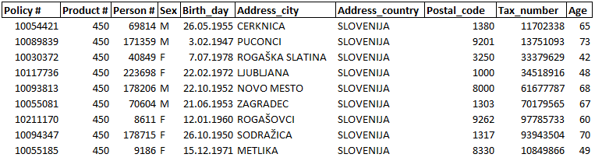
Data type
Data from the database of a typical Slovenian insurance company
178.744 unique policyholders (i.e. records) and contains 27 different coverages per cut-off date
Additional data of policyholders, such as unique identification, demographic and location data was additionally collected and collated

Slide 4
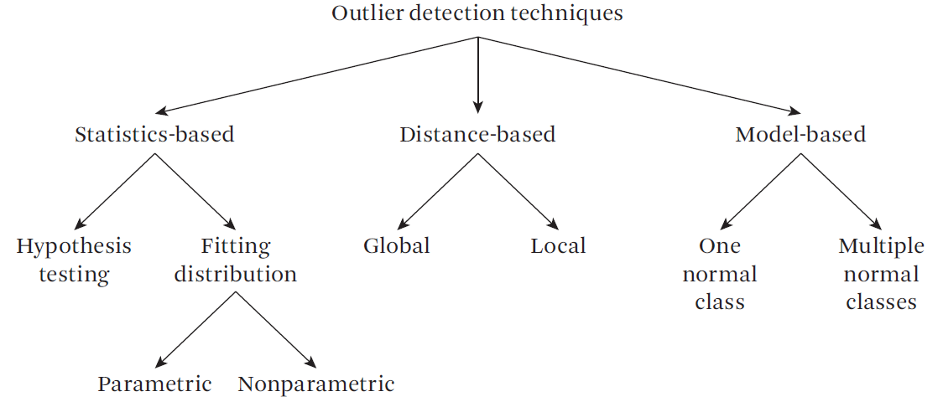
Outlier detection techniques

Slide 5
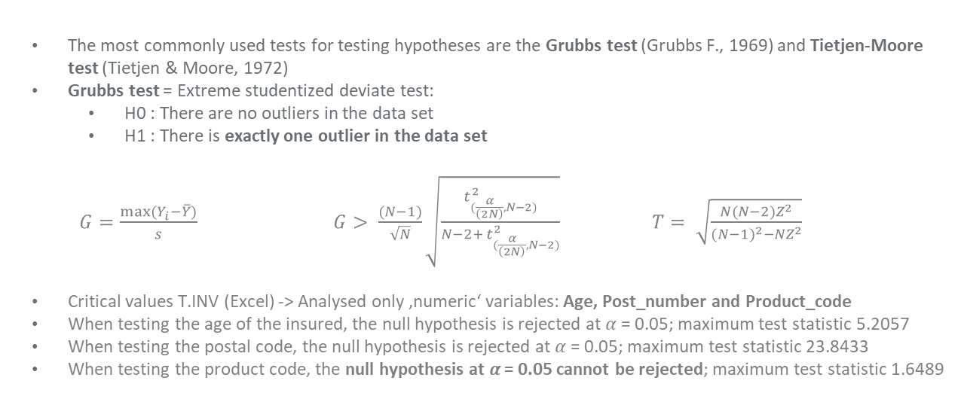
Statistical methods– 1st part
The most commonly used tests for testing hypotheses are the Grubbs test (Grubbs F., 1969) and Tietjen-Moore test (Tietjen & Moore, 1972)
Grubbs test = Extreme studentized deviate test:
  H0 : There are no outliers in the data set
  H1 : There is exactly one outlier in the data set
  $G=\frac{max⁡(Y_{i}−\overline{Y})}{s}$ $G> \frac{(N−1)}{\sqrt{N}}\sqrt{\frac{t_{(\frac{α}{\left(2N\right)}, N−2)}^{2}}{N−2+ t_{(\frac{α}{\left(2N\right)}, N−2)}^{2}}}$ $T= \sqrt{\frac{N(N−2)Z^{2}}{{(N−1)}^{2}−{NZ}^{2}}}$
Critical values T.INV (Excel) -> Analysed only ‚numeric‘ variables: Age, Post_number and Product_code
When testing the age of the insured, the null hypothesis is rejected at 𝛼 = 0.05; maximum test statistic 5.2057
When testing the postal code, the null hypothesis is rejected at 𝛼 = 0.05; maximum test statistic 23.8433
When testing the product code, the null hypothesis at 𝛼 = 0.05 cannot be rejected; maximum test statistic 1.6489

Slide 6
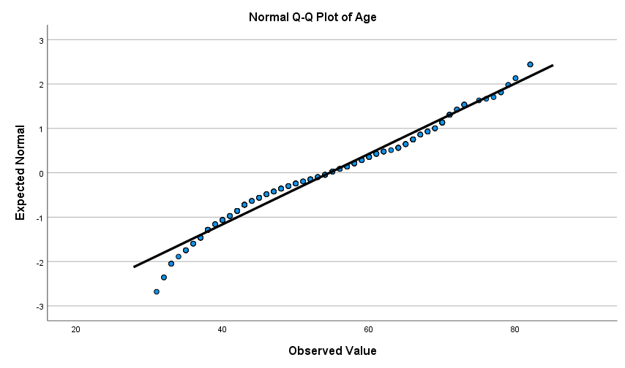
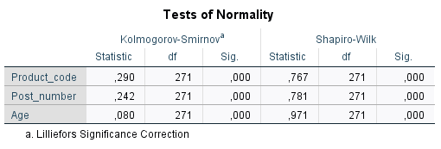
Normality test
Are my variables: Age, Post_number and Product_code normally distributed?
The variables analyzed are clearly not normally distributed

Slide 7
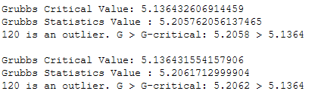


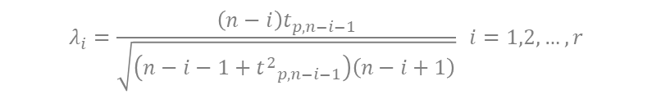
Statistical methods– 2nd part
Tietjen-Moore test: generalization of the Grubbs test. Initially, you have to define the number of outliers
Generalized ESD test: detection of one or more outliers in a univariate dataset. As input, it only requires an upper limit on the estimated number of outliers
  H0 : There are no outliers in the data set
  H1 : There are up to r outliers in the data set
$$R_{i}=\frac{\max_{i}\left|x_{i}−\overline{\left.x\right|}\right.}{s}$$
$$λ_{i}=\frac{{\left(n−i\right)t}_{p,n−i−1}}{\sqrt{\left(n−i−1+{t^{2}}_{p,n−i−1}\right)\left(n−i+1\right)}} i=1,2,…,r$$
$$p=1−\frac{α}{2\left(n−i+1\right)}$$
When testing the age of the insured the test returned two outliers
When testing the Post_number the method incorrectly identifies all 5 digit city zip codes that belong to locations abroad. The test correctly returns errors in case of incorrect entry of the postal code in the form of text, but does not reject in case of entering the number 0 instead of the postal code.

Slide 8
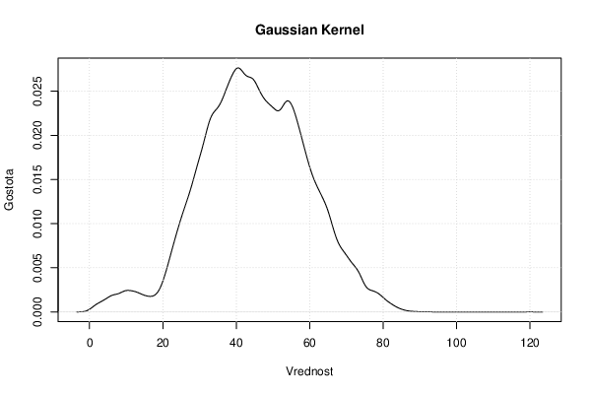
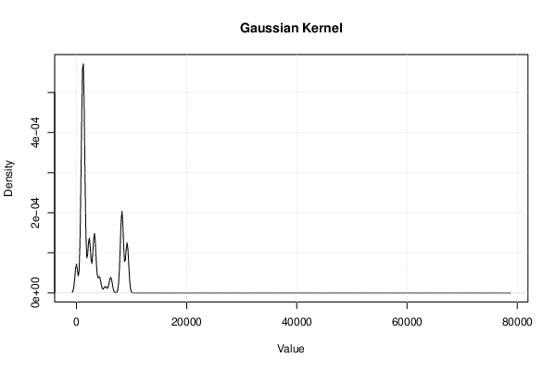
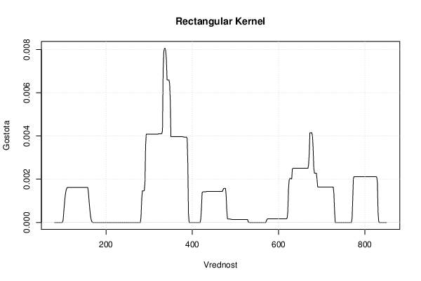
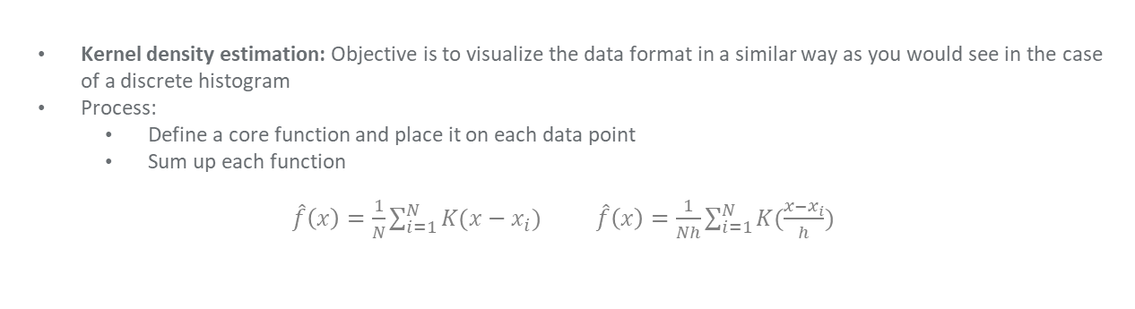
Statistical methods– 3rd part
Kernel density estimation: Objective is to visualize the data format in a similar way as you would see in the case of a discrete histogram
Process:
  Define a core function and place it on each data point
  Sum up each function
$\hat{f}\left(x\right)=\frac{1}{N}\sum_{i=1}^{N}{K(x−x_{i}})$ $\hat{f}\left(x\right)=\frac{1}{Nh}\sum_{i=1}^{N}{K(\frac{x−x_{i}}{h}})$

Slide 9


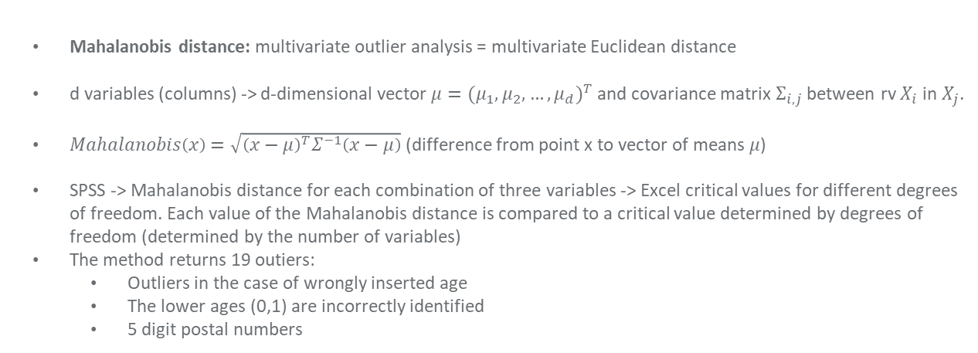
Distance based methods– 1st part
Mahalanobis distance: multivariate outlier analysis = multivariate Euclidean distance
d variables (columns) -> d-dimensional vector $μ{=(μ_{1},μ_{2},…,μ_{d})}^{T}$ and covariance matrix $Σ_{i,j}$ between rv $X_{i}$ in $X_{j}$.
$Mahalanobis\left(x\right)=\sqrt{{\left(x−μ\right)}^{T}Σ^{−1}\left(x−μ\right)}$ (difference from point x to vector of means 𝜇)
SPSS -> Mahalanobis distance for each combination of three variables -> Excel critical values for different degrees of freedom. Each value of the Mahalanobis distance is compared to a critical value determined by degrees of freedom (determined by the number of variables)
The method returns 19 outiers:
  Outliers in the case of wrongly inserted age
  The lower ages (0,1) are incorrectly identified
  5 digit postal numbers

Slide 10
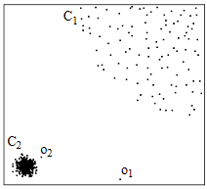
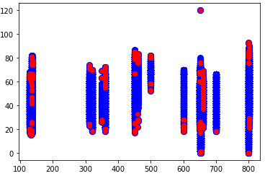
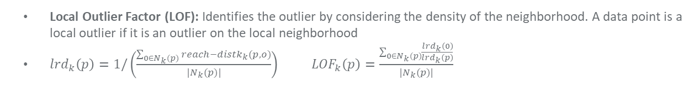
Distance based methods– 2nd part
Local Outlier Factor (LOF): Identifies the outlier by considering the density of the neighborhood. A data point is a local outlier if it is an outlier on the local neighborhood
${lrd}_{k}\left(p\right)=1/\left(\frac{\sum_{0∈N_{k}(p)}{{reach−distk}_{k}(p,o)}}{|N_{k}(p)|}\right)$ ${LOF}_{k}\left(p\right)=\frac{\sum_{0∈N_{k}(p)}{\frac{{lrd}_{k}\left(0\right)}{{lrd}_{k}\left(p\right)}}}{|N_{k}(p)|}$
Local outlier factor method (LOF)
Age
Product_code

Slide 11
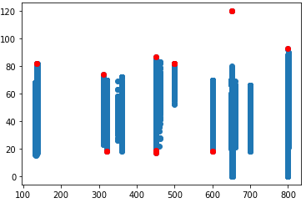
Model based methods
Model based = learned classifier applied to data to see if a point is an outlier
Support vector machines (SVM): divides a set of objects into classes so that the space without objects between classes or the separation boundary is as wide as possible
Goal: Find hyperplane that separates the classes the most. The hyperplane cannot be bent
Support vector machines (SVM)
Age
Product_code

Slide 12
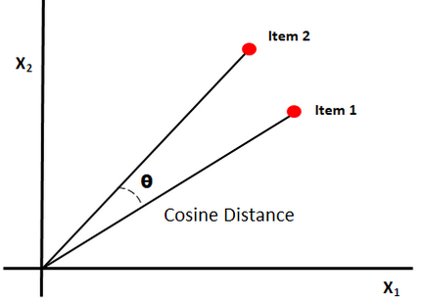
Deduplication
In different databases, the same entities are written differently; there are double entries; the customer used a different name at the time of purchase etc.
The goal is to find the true entity that most uniformly represents duplicate records (Ananthakrishna & Ganti, 2002).
Use the method of fuzzy deduplication (also tried record lincage)
Identifies mostly similar records
Similarity determined by cosine similarity -> text to vector -> Compare the angle between the vectors
The method also takes into account: n-gram (also separates the sequence of the sentence) + sensitivity / accuracy + TF-IDF
Intermediate steps : »Do these records refer to the same thing? (y)es / (n)o / (u)nsure / (f)inished«.
The method found no duplicate records

Slide 13
Rule based cleaning
All other methods have difficulty finding logical errors
Rule-based repairing methods are widely adopted e.g., ETL rules
Formerly functional dependency and inclusion dependency -> today conditional functional dependency and conditional inclusion dependency
Example: Consumer([CC= 01,AC= 908,PHN] → [street,city=‘MH’, phone number]),
Our example:
  Tax_number([left(TN,3)=KNL] → [Product_code=800,801])
  Tax_number([TN=∅] → [Product_code =361,660,800,801])
We found incorrectly entered country names, blank entries, and incorrectly entered policyholder ages

Slide 14
Conclusion
For data containing more than one data type we have to use completely different methods for database analysis
  Use statistical methods when your numerical variables are normally distributed + visual representation
  Use a combination of statistical and model based to extract knowledge from data i.e. data mining
  Use deduplication when examining on whole dataset that contains text and numeric data
  Use rule based to find missing logical errors
We have used Python, SPSS, Excel and Wessa.net to analyse the data in different ways and from different angles
With the mentioned methods, we discovered a multitude of errors in the data, which, if left undiscovered, would completely distort the results of further research!

Slide 15
Attachments and computer code
The methods programmed in the Python 3 environment are presented via Jupyter Noterbooks and published publicly on the following GitHub account:
https://github.com/MarkoSum
Computer code:
  Fuzzy deduplication.ipynb
  Outlier detection LOF.ipynb
  SVM outlier detection.ipynb
  Generalized ESD test.ipynb
Other documents are on my Google Drive -> email: marko.sumina@gmail.com

Slide 16
THANK YOU!
Do you have any questions?

