Slide 1

hIddeN CovID-19 casEs Network esTimation
Honoria Ocagli
PhD student Unit of Biostatistics, Epidemiology and Public Health, Department of Cardiac, Thoracic, Vascular Sciences, and Public Health, University of Padova, Italy

Slide 2
Background
Recent literature evidences a high percentage of asymptomatic or paucisymptomatic cases among COVID-19 infected subjects.
The prevalence estimation for mild-asymptomatic cases is very important given the high contagiousness of the virus.
INCIDENT (hIddeN CovID-19 casEs Network esTimation),
aims at estimating the number of undocumented infections of COVID-19 using the NSUM method
Notes:
Recent literature has evidenced a high percentage of asymptomatic or paucisymptomatic cases among COVID-19 infected subjects. The prevalence estimation of these cases is quite relevant given the high contagiousness of the virus. Hence, the creation of the study INCIDENT: hIddeN CovID-19 casEs Network estimation.
Prevalence estimates are required primarily in three key areas, service planning and resource allocation, monitoring key targets, and public health surveillance/epidemiology.

Slide 3
Study design & procedures
Study design
Sample size
Inclusion criteria
Snowball social network sampling
Structured only for electronically diffusion
(created in LimeSurvey - GmbH, Hamburg/German)
Procedures
>16 years old
Informed consent
The computed study size is of 2178 responders (conservative proportion, 2.1% error rate)
Notes:
This is a cross-sectional survey-design study with a snowball social network sampling. The questionnaires were collected between 15 April 2020 and 6 May 2020.

Slide 4
The questionnaire
Target questions
(n 4)
paucisimptomatic people,
covid-19 positive,
quarantined people.
Tuning question
(n 1)
Random question about a known population
(e.g.: How many couple who were married in 2019 do you know?)
Demographic characteristics
(n 4)
Age,
gender,
residence,
nationality.
Notes:
The questionnaire is structured into three sections: i) demographic characteristics ii) four target questions related to COVID-19 disease. And one question randomly drawn from 15 known populations.

Slide 5
Definitions:
Hard-to-reach/hidden populations
Hard-to-reach
Hidden
“sub-groups of the population that are difficult to reach or involve in research or public health programmes due to their physical and geographical location or their social and economic situation”
Conducting research into hidden or hard-to-reach populations.Sydor A Nurse Res. 2013 Jan; 20(3):33-7.
“those who do not wish to be found or contacted (e.g. illegal drug users or migrants and homeless people)”
Lambert EY, Wiebel WW, editor. The Collection and Interpretation of Data from Hidden Populations. Washington, DC: United States National Institute on Drug Abuse; 1990. from
Notes:
Accurate and timely information about the number of these populations is necessary for:
the design and evaluation of public health policy as well,
the allocation of resources for treatment and prevention programmes.

Slide 6
Indirect sample estimation methods
Enumeration methods
Capture–recapture techniques
Multiplier methods
Synthetic estimation and multivariate indicator methods
computationally intensive and may require data for each area in the country for which the estimate will apply.
requires two sources of data; one source is a direct count of the target population participating in a service, while the other source is a representative sample of the target population
require two or more valid, representative and independent samples of a population
can involve months of fieldwork to access individuals and still fail to identify individuals who practice the behaviour.
Notes:
In those population direct methods are impracticable or unreliable.
The aim of the indirect estimation methods is to analyze the observed data set or combine it with other information to estimate the “proportion of the hidden - target population sampled within the observed data set”, and thereby to arrive at an estimate of the prevalence

Slide 7
Multiplier method
Benchmark (B) | Number of HIV tests by injecting drug users in 1996—Source: laboratory reports | 4050
Multiplier (M) | Proportion of injectors reporting getting an HIV test in the previous year—Source: community recruited survey of injectors | 23% (multiplier = 1/0.23 = 4.35)
Prevalence estimate | B*M = 4050*4.35 | 17600
Table 1 Multiplier study based on the study of Archibald and colleagues, 2001
Assumption:
- sample stable in benchmark recording and during multiplier estimation
Archibald, C.P., Jayaraman,G.C., Major, C., Patrick, D.M., Houston, S.M., and Sutherland, D. (2001). Estimating the size of hard-to-reach populations: a novel method using HIV testing data compared to other methods. AIDS 15 (suppl3), pp. S41–48.
Notes:
Two elements are required: first, a data source usually called a “benchmark” (representing a known number of problem drug users that have experienced a particular event, such as treatment or arrest or overdose); second, an estimate of the proportion of all problem drug users that have been recorded in the benchmark.
In essence, the multiplier is a two-source method (one source is the benchmark, the other is the data used to provide the estimate of the proportion and multiplier).
The assumptions of the multiplier method are: the population of problem drug users needs to be stable and the same during the benchmark recording as during the multiplier estimation; the sample that is used to estimate the multiplier should be representative of the overall population of problem drug users, in practice not easily done; and, it is important that the definition used for the benchmark is precise and matches exactly that used in estimating the multiplier
Various methods have been used to derive the multiplier, all attempting to approximate a random sample of drug users from which to estimate it. These include—not always successfully—site sampling methods (sampling drug users present at a representative set of geographical sites), and ‘community sampling’ (chain referral or snowball techniques that attempt to produce a representative sample of all drug users) and nomination (e a sample (e.g. injecting drug users) are asked questions about their friends or acquaintances (their nominees) that also are injecting drug users)

Slide 8
Capture recapture
 |  | Arrestees with urine positive for opiates (S2)
Methadone maintenance (S1) |  | yes | no
 | Yes | 171 (m) | 3893 | 4064 (n1)
 | No | 1369 | x
 |  | 1540 (n2) |  | N
population estimate, N = n1*n2 / m = 4064 * 1540 / 171 = 36599
number observed, n, = a + b + c = 171 + 3893 + 1369 = 5433
hidden, x, = N − n, = 36,599 − 5433 or, c * b / a 1369 * 3893 / 171 = 31166
95%c.i. = 1.96 * √(n1 ∗ n2 ∗ b ∗ c)/m3 = 1.96* √(1540 ∗ 4064 ∗ 3893 ∗ 1369)/1713 = 4516
Rounded Estimate of IU in Bangkok in 1991 = 36600 (32000 to 40800)
a or m = marks, number of people in both S1 and S2
b = number in S1 but not S2 c = number in S2 but not in S1
x = hidden population, number of people not in S1 or S2
n1 = number of people in S1
n2 = number of people in S2
N = total population
Mastro, T.D., Kitayaporn, D.,Weniger, B.G., Vanichseni, S., Laosunthron, V., Thongchai, U., Uneklabh, V., Vhoopanya, K. and Kimpakarnjanarat, K. (1994). Estimating the number of HIV-infected injection drug users in Bangkok: a capture-recapture method. American Journal of Public Health 84, pp. 1094–1099.
Notes:
Capture-recapture involves the collection of three or more data sources of problem drug users with sufficient detail on the subjects to identify matches between data sources.
Information on the number of matches between the data sources (i.e., the number of people that occur in more than one data source) is used to estimate the sampling intensity (i.e., the total proportion of injectors in the samples). These estimates of the number unobserved are then combined with the number in the data sources to generate the overall prevalence estimate. Studies with two samples can be easily calculated (see below).

Slide 9
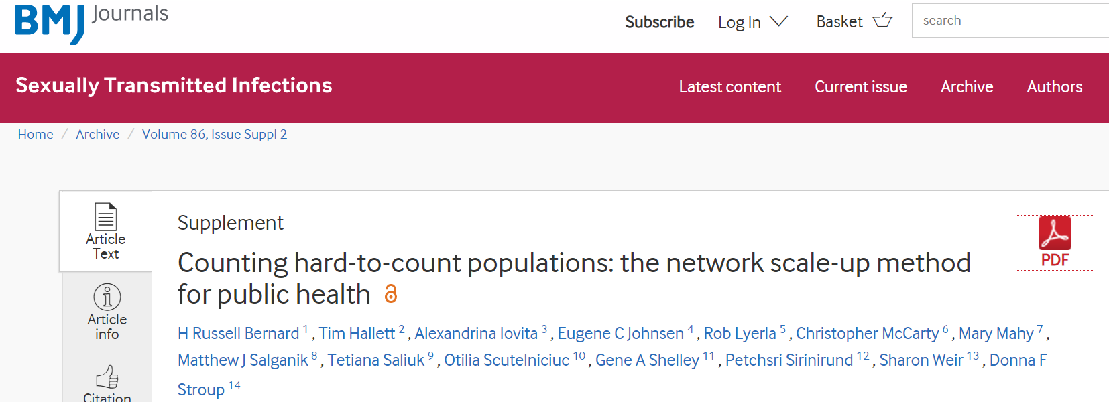
Notes:
The Network scale up method, in its simplest form, as explained by its father Dr. Bernard “rests on the assumption that people’s social networks are, on average, representative of the general population in which you live and move”.
NSUM method has been widely used to estimate hard-to-reach populations such as HIV positive people

Slide 10
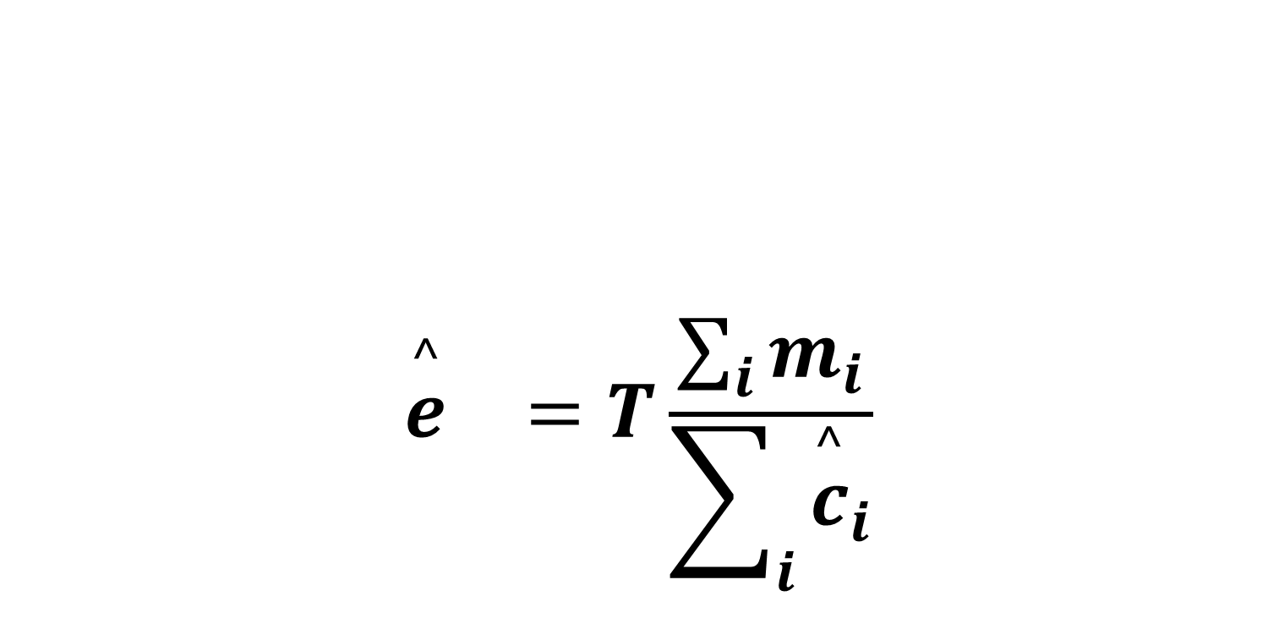

The network scale-up method (1)
$${\overset{^}{e}}_{}=T\frac{\sum_{i}{m_{i}}}{\sum_{i}{{\overset{^}{c}}_{i}}}$$
size of the general population
the number of people in the hidden population known by person i
the estimated size of the hidden population
the estimated personal network size of the person i
$${\overset{^}{e}}_{k}=T\frac{\sum_{i}{m_{ik}}}{\sum_{i}{{\overset{^}{c}}_{i}}}$$
Notes:
The NSUM estimator ${\overset{^}{e}}_{}$ of the target population size could be defined by the following equation: where
e is the estimated size of the hidden population,
m_{i} is the number of people in the hidden population known by person i,
ĉ_{i} is the estimated personal network size of person i, and N is the size of the general population.
The size of the general population, N, is assumed to be known (from sources such as census information), whereas m_{i} and ĉ_{i} are determined from data collected in network scale-up survey interviews.
In this case, if a sample of respondents report knowing 300 people on average, two of whom inject drugs, we estimate that 2/300th of the general population inject drugs. We combine this estimated prevalence with known information about the size of the general population to produce an estimate for the number of people in the population who inject drugs.

Slide 11
Component of the NSUM calculation (1)
The known population method
m_{i} → number of people they know with the behaviour of interest
ĉi, → number of people they know in various populations of known size.
Accuracy with the number of known populations used
Accuracy of the estimate can be improved by combining responses from many respondents
Notes:
Respondents are asked to supply the number of people they know with the behaviour of interest (eg, ‘How many people do you know who inject drugs?’); answers to these questions are the m_{i} in equation (1).
Respondents are also asked to estimate their personal network size (ie, their numbers of social acquaintances, called their network degrees), the ĉ_{i} in equation (1).
The accuracy of the estimate increases with the number of known populations used, we recommend using at least 20 subpopulations.
May be biased, depending on the known-size populations used for estimation.
For example, if a respondent in Egypt reports knowing five people named Ahmed, one could combine that with the fact that there were about 2 million men named Ahmed in the country (using birth registration data from 2008). We could estimate that the respondent knows about 5/(2 000 000) = 0.0000025 of all Egyptians. As there are approximately 90 million Egyptians (from census data), we would estimate that the respondent has a personal network size of 225.

Slide 12
Definitions of “knowing someone”
“they live in the area (to which the estimate will apply), you know them, they know you, you have had contact with them in the last 2 years, and you could get in touch with them if needed.”
Killworth PD, McCarty C, Bernard HR, et al. Estimation of seroprevalence, rape, and homelessness in the United States using a social network approach. Eval Rev 1998;22:289–308
Notes:
a fundamental concept underlying NSUM is the definition of what it means to have a person in one's personal network or what it means ‘to know’ someone.
This definition may be adjusted in response to local culture and language, but respondents need a clear and consistent definition of how to classify people into their personal networks.

Slide 13
Component of the NSUM calculation (2)
The summation method
Respondents are asked to enumerate the people they know in a list of specific relationship types or categories.
easier for respondents to provide accurate answers
it does not require data for populations of known size.
Difficult to construct a list of perfectly mutually exclusive groups
Notes:
when data for known populations may be missing or unreliable the summation method could be used to estimate personal network size.
May be easier for respondents to provide accurate answers and it does not require data for populations of known size.
Difficult to construct a list of perfectly mutually exclusive groups (eg, someone who is a coworker may also be a neighbour), which potentially leads to overcounting.

Slide 14

Our NSUM approach (1)
Resampled from a binomial random variable
size of the general population
the number of people in the hidden population k known by person i
$${\overset{^}{e}}_{k}=T\frac{\sum_{i}{m_{ik}}}{\sum_{i}{{\overset{^}{c}}_{i}}}$$
Stratification according to gender, age, region
Partially unknown
the estimated size of the hidden population k
Total population
the estimated personal network size of the person i
Notes:
The NSUM estimator ${\overset{^}{e}}_{}$ of the k population could be defined according to our approach following the equation reported in the slide.
where the structure is the same as that proposed by Bernard.
We considered multiple hidden population and
m_{i} is the number of people in the hidden population known by person I is resampled from a Binomial random variable
ĉ_{i} is the estimated personal network size of person I and is partially unknowm
and N is the size of the general population.

Slide 15
Our NSUM approach (2)
Our approach
Traditional approach
N | Questions
Q1 | Age
Q2 | Gender
Q3 | Residence
Q4 | Nationality
Q5 | N paucisintomatic covid
Q6 | N swab covid positive
Q7 | N cohabitant of isolated covid
Q8 | N transfer after DPCM
Q9 | 1 Random known population
N | Questions
Q1 | Age
Q2 | Gender
Q3 | Residence
Q4 | Nationality
Q5 | N paucisintomatic covid
Q6 | N swab covid positive
Q7 | N cohabitant of isolated covid
Q8 | N transfer after DPCM
Q9 | Q1 known population
Q10 | Q2 known population
Q11 | Q3 known population
Q12 | Q4 known population
Q13 | Q5 known population
Q14 | Q6 known population
Q15 | Q7 known population
Q16 | Q8 known population
Q17 | Q9 known population
Q18 | Q10 known population
Q19 | Q11 known population
Q20 | Q12 known population
Q21 | Q13 known population
Q22 | Q14 known population
Q23 | Q15 known population
Notes:
In this slide is visible the difference in the length of the questionnaire with our approach and with the traditional approach considering 15 subpopulation of known population to estimate the c component, which is the social network size.
With our approach the overall number of questions to pose are 9, with the traditional approach, even in the Bayesian framework of Maltiel at least 23 questions.

Slide 16
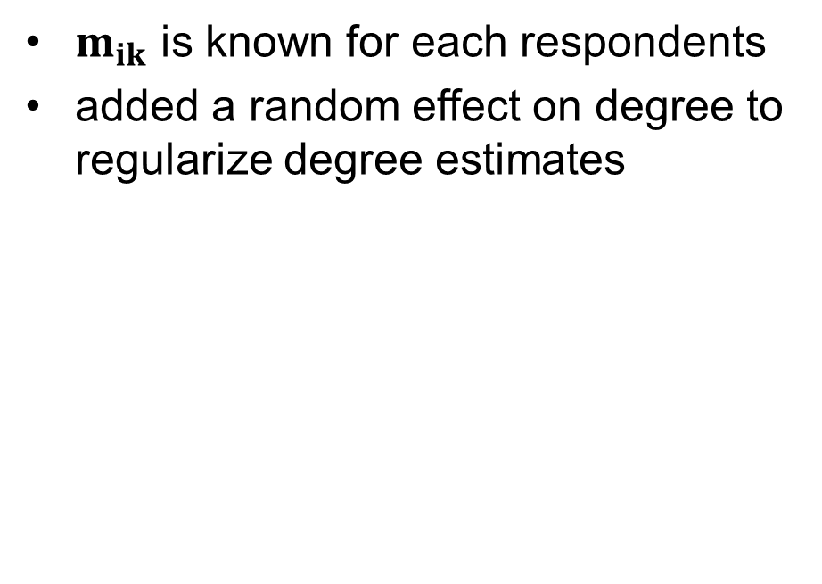


Our NSUM approach (3)
Maltiel
Our approach
$m_{ik}$ is known for each respondents
added a random effect on degree to regularize degree estimates
$m_{ik}$ has been iteratively resampled during the MCMC estimation procedure from a Binomial random variable
$$m_{ik}\sim Binom\left(c_{i},\frac{T_{k}}{T}\right)$$
$$c_{i}\sim logNorm\left(μ,σ^{2}\right)$$
Random degree model
Notes:
Maltiel created the random degree model which follows the binomial assumption of the Killworth et al. (1998b,a) model while adding a random effect on degree to regularize degree estimates. This happens when an individual responded that he or she knew a large number of people in a given subpopulation
In our approach, in comparison with the original Bayesian method, the $m_{ik}$ the network size value is not a realization of a random variable but has been iteratively resampled during the MCMC estimation procedure from a Binomial random variable whose parameters are characterized by the personal network size degree ($c_{i}$) and the overall known proportion of subjects i in the subpopulation k ($\frac{T_{ik}}{T}$) over the total population.
The individual degree iperparameter follow a log normal distribution with parameters mean, mu and variance sigma squared.
They choose a log normal distribution for ci based on the observed distribution of scale-up estimates of degree across multiple datasets.

Slide 17
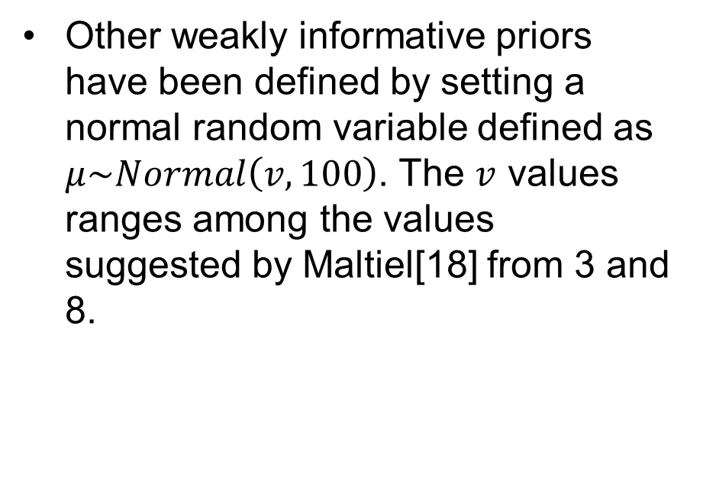
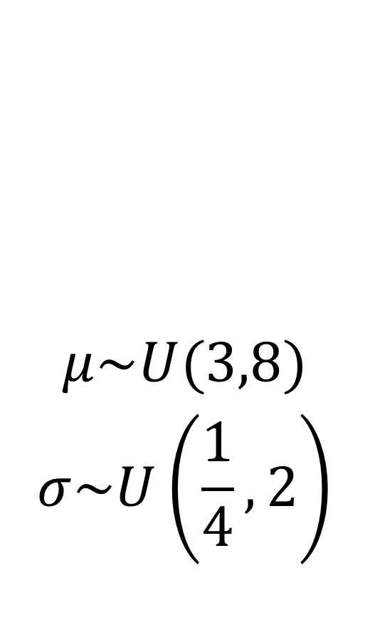
Prior distribution
$$\begin{aligned}μ\sim U(3,8) \\ σ\sim U\left(\frac{1}{4},2\right)\end{aligned}$$
Maltiel
Our approach
Other weakly informative priors have been defined by setting a normal random variable defined as $μ\sim Normal\left(v,100\right)$. The $v$ values ranges among the values suggested by Maltiel[18] from 3 and 8.
Notes:
The random degree model parameters have been estimated in a Bayesian approach
The priors for μ and σ were arrived at from the values we saw in fitting the scale-up dˆi estimates to several datasets across multiple regions as reported in Maltiel.
The prior for μ allows for mean degrees within a data set ranging from 20 to 3,000, which is consistent with previous research on social networks and the NSUM
The $v$ values ranges among the values suggested by Maltiel[18] from 3 and 8 in a log scale *da esponenziare(.

Slide 18
Performance of our approach
Study Size | Maltiel’s Method |  |  |  | Modified Maltiel’s Method
 | Benchmark Prevalence | Prevalence% | 95% CI Length | Bias | Prevalence% | 95% CI Length | Bias
1000 | 1.37 | 1.324 | 0.056 | −0.056 | 1.561 | 0.074 | 0.191
1500 | 1.37 | 1.327 | 0.044 | −0.053 | 1.57 | 0.056 | 0.200
2000 | 1.37 | 1.329 | 0.038 | −0.051 | 1.567 | 0.044 | 0.197
2500 | 1.37 | 1.329 | 0.031 | −0.051 | 1.566 | 0.038 | 0.196
3000 | 1.37 | 1.33 | 0.025 | −0.05 | 1.574 | 0.032 | 0.204
Table Simulation results for the modified Maltiel’s method performance.
Notes:
The performance of the proposed NSUM estimator was evaluated in a simulation study considering different study size scenarios (1000, 1500, 2000, 2500, 3000).
Data were generated 300 times using the original nsum.simulate() function proposed by McCarty in the NSUM R package
The benchmark prevalence represents the true value used to generate the data. The bias (average estimated prevalence—benchmark) was reported for each method.
For each replication, Maltiel’s NSUM model and our NSUM proposal were estimated with 500 iterations, discarding the first 50 (burn-in iterations).

Slide 19
Results (1)
Variable | N | Veneto (N = 711) | Lombardia (N = 116) | Piemonte (N = 657) | Overall (N = 1484)
Age | 1484 | 28.00/39.00/52.00 | 25.00/31.00/45.25 | 29.00/41.00/52.00 | 28.00/39.00/52.00
Gender: Female | 1484 | 58% (411) | 56% ( 65) | 64% (419) | 60% (895)
N undocumented cases | 1434 | 0.00/0.00/2.00 | 0.00/1.00/3.25 | 0.00/1.00/3.00 | 0.00/1.00/2.00
N swab covid positive | 1413 | 0/1/2 | 0/1/3 | 0/1/3 | 0/1/3
N cohabitant of isolated covid | 1387 | 0/0/1 | 0/1/3 | 0/1/2 | 0/0/2
N transfer after DPCM | 1373 | 0/0/1 | 0/0/2 | 0/0/1 | 0/0/1
People who separated | 76 | 0.00/0.00/1.00 | 0.75/1.50/2.50 | 0.00/1.00/2.00 | 0.00/0.50/2.00
Foreign residents | 92 | 0.00/ 3.00/10.25 | 1.00/ 2.00/ 5.00 | 2.00/ 6.00/17.50 | 1.00/ 4.00/12.75
Victims of car accident with injuries | 94 | 0.75/1.00/3.00 | 0.50/2.00/4.50 | 0.50/2.00/4.00 | 0.25/1.50/4.00
People who graduated | 84 | 0.00/1.00/3.00 | 0.75/2.00/6.25 | 0.50/2.00/5.00 | 0.00/2.00/5.00
People working part-time | 91 | 1.00/ 3.00/ 7.25 | 2.00/ 3.50/16.25 | 1.00/ 3.00/ 5.50 | 1.00/ 3.00/ 7.00
3-member families | 80 | 3.00/10.00/20.00 | 4.75/ 8.00/12.50 | 5.00/15.00/22.50 | 4.00/10.00/20.00
Cohabiting couples | 87 | 4.00/10.00/20.00 | 11.50/20.00/20.00 | 6.25/11.00/37.50 | 5.00/10.00/30.00
Children born | 103 | 0/1/2 | 0/1/1 | 0/1/2 | 0/1/2
People who attend places of worship | 100 | 3/ 15/100 | 5/ 10/150 | 02/10/2020 | 03/10/1950
People with smoking habits | 88 | 10.00/23.50/50.00 | 10.25/20.00/42.50 | 9.25/15.00/20.00 | 10.00/18.50/40.00
People who walk to work | 85 | 0.0/0.0/3.0 | 0.0/0.0/0.0 | 1.0/2.0/9.5 | 0.0/1.0/5.0
People who go to school by bus | 80 | 0.00/ 2.00/ 7.00 | 0.75/ 8.00/17.75 | 0.00/ 2.00/10.00 | 0.00/ 2.00/10.00
People who married | 92 | 0.00/2.00/2.00 | 0.00/1.00/2.75 | 0.00/1.00/2.00 | 0.00/1.00/2.00
People using the mass media | 92 | 30/ 50/150 | 35/100/125 | 20/ 50/125 | 25/ 50/150
People who used a PC and Internet | 78 | 0.0/ 1.0/ 6.0 | 2.0/ 3.0/ 4.5 | 1.0/ 3.5/10.0 | 0.0/ 3.0/10.0
Demographic
Target
questions
Known populations questions
Notes:
Table 2 reports the main characteristics of the sample according to the three regions considered in the analysis of the estimate of COVID-19 positive.
. The response rate was of 94% (1845 complete answers, 1963 total respondents).
The median age was similar in Veneto and Piemonte.
In Lombardia and Piemonte respondents report a median of 1 person with symptoms related to COVID-19

Slide 20
Results (2)
 |  | Veneto |  |  | Piemonte |  |  | Lombardia
 | mu | Posterior median | Lower Bound | Upper Bound | Posterior median | Lower Bound | Upper Bound | Posterior median | Lower Bound | Upper Bound
Swab COVID-19 positive | 3 | 11542 | 10902 | 11600 | 18335 | 18027.71 | 18825.08 | 267067 | 246694 | 284537
 | 4 | 13547 | 13435 | 14163 | 19215.29 | 18676.38 | 19726.62 | 180796 | 173446 | 195074
 | 5 | 13705 | 13272 | 14130 | 19138.22 | 18926.75 | 19608.57 | 178609 | 156149 | 207736
 | 6 | 13878 | 13159 | 15267 | 19265.03 | 18462.55 | 21202.12 | 177297 | 165553 | 193672
 | 7 | 13972 | 13556 | 14385 | 19536.66 | 18871.61 | 19726.41 | 180969 | 164401 | 200029
 | 8 | 13728 | 12545 | 14706 | 19616.65 | 18909.19 | 19929.14 | 177847 | 162373 | 206540
Undocumented cases | Default | 11451 | 10837 | 12468 | 18695.24 | 17974.08 | 19339.36 | 277132 | 252555 | 279693
 | 4 | 11580 | 10601 | 12288 | 18025.46 | 17152.35 | 19259.48 | 274273 | 260158 | 288069
 | 5 | 11577 | 11181 | 12387 | 18254.71 | 17709.69 | 18719.77 | 265877 | 255915 | 285173
 | 6 | 11385 | 11133 | 11833 | 18153.81 | 17832.95 | 18705.46 | 277824 | 265165 | 304146
 | 7 | 11621 | 10903 | 11835 | 17377.09 | 17377.09 | 19166.75 | 261914 | 255746 | 287323
 | 8 | 11577 | 10712 | 11961 | 17970.98 | 17266.65 | 20332.62 | 272026 | 244755 | 286921
Table swab covid positive estimates for each region
*Estimates have been derived after a 2000 MCMC interation and 100 burn in.
Notes:
We estimated the size of the hidden cases of COVID-19 in 3 regions of Italy, Veneto, Lombardia and Piemonte in the first period of COVID-19 spread
This Table reports the estimates with different mu for each target questions for each region.

Slide 21
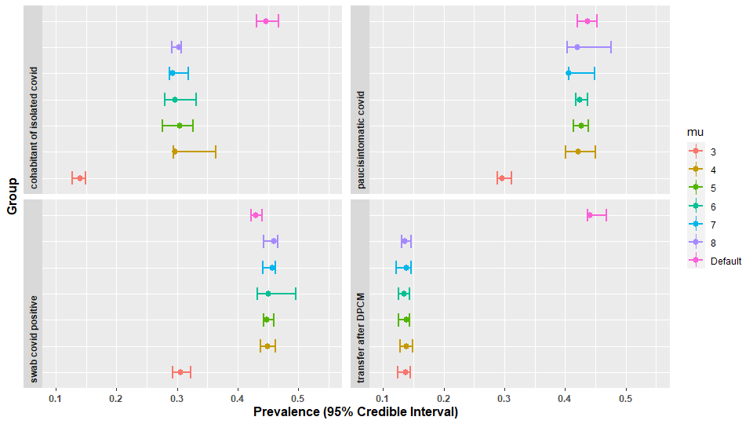
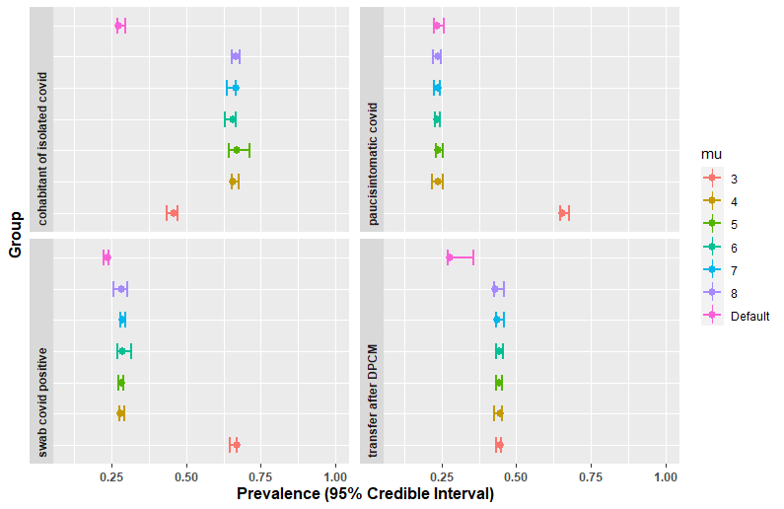
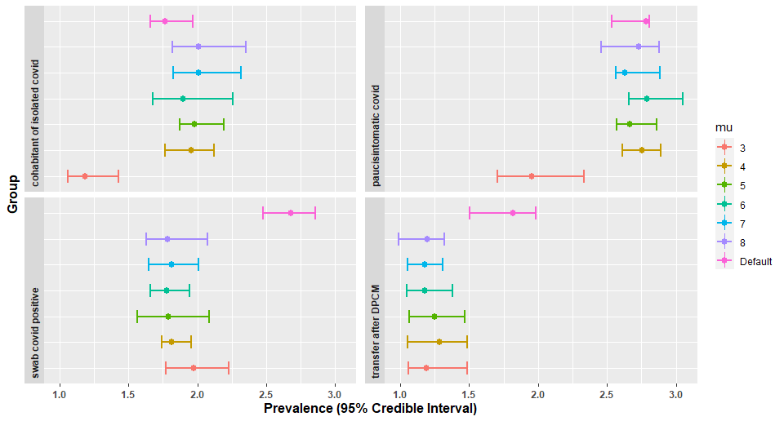
Results 3
B
Figure 2 Prevalence of the target questions in the Veneto (A), Piemonte (B) and Lombardia (C) regions.
A
C
Notes:
In the figure are reported the prevalence with 95% Credible Interval for the target questions respectively for Veneto, Piemonte and Lombardia.
For the Veneto region the average prevelence derived from admnistrativa data is 0.21. Our estimatesboth for swab COVID positive and undocumented cases are a little bit higher.
The same is for Piemonte, the average prevalence was of 0.41.
Our estimates in Lombardia are lower compared to administrative data which refers an average prevalence of 0.48.
The estimates of undocumented cases is higher for Piemonte and Lombardia and Lower for Veneto.

Slide 22
Discussion
Different policy of mass testing
undocumented cases can explain country-specific mortality-prevalence, countries with high mortality could have a high proportion of undocumented infections.
Other models were applied to identify undocumented cases, however those required direct access to data
For Veneto and Piemonte our model overestimates the COVID-19
Notes:
Our difference in the estimate may be explained by the different policy of mass testing applied in the three regions considered.
Veneto started an early mass testing policy, instead Lombardia started later. Moreover the answer in the Lombardia region are lower and this is visible in the large confidence intervals in the estimates.
This is reasoning loss is power with the advancing of the pandemic along with the increase of mass testing

Slide 23
Advantages
does not access the target population directly, rather a random sample of the general population report about members of the target population.
data needed for the numerator and denominator of equation (1) can be collected in two different samples with different sizes
N represents the known size of the total population, not a multiplier benchmark.
Traditional NSUM
Shorter questionnaire
Increase response rate
Possibility to stratify respondents according to demographic characteristics
Our NSUm approach

Slide 24
Limits of NSUM method
estimate may be biased, depending on the known-size populations used for estimation
Transmission error
Response bias
Barrier effects
Notes:
- The application of the NSUM requires the assumption that the network of social contacts in the general population is essentially random
- field implementation has shown that respondents under-report the number of people known in larger populations and over-report the number known in smaller populations.
- transmission error is particularly likely in settings where the behaviour of interest is highly stigmatised.
people may know someone in a hidden population and be aware of that fact, but not report this information in an interview because of the sensitive nature of the behaviours involved.
propensity to know people in particular subgroups

Slide 25
References
Bernard H.R., Johnsen E.C., Killworth P.D., Robinson S. Estimating the Size of an Average Personal Network and of an Event Subpopulation: Some Empirical Results. Soc. Sci. Res. 1991;20:109–121. doi: 10.1016/0049-089X(91)90012-R.
Maltiel, R.; Raftery, A.E.; McCormick, T.H.; Baraff, A.J. Estimating Population Size Using the Network Scale Up Method. Ann Appl Stat 2015, 9, 1247–1277, doi:10.1214/15-AOAS827.
Maltiel R., Baraff A.J. NSUM: Network Scale Up Method; R package version, 1. [(accessed on 16 april 2020)];2015 Available online: https://cran.r-project.org/web/packages/NSUM/NSUM.pdf.
Killworth P.D., McCarty C., Bernard H.R., Shelley G.A., Johnsen E.C. Estimation of Seroprevalence, Rape, and Homelessness in the United States Using a Social Network Approach. Eval. Rev. 1998;22:289–308. doi: 10.1177/0193841X9802200205

Slide 26
Thanks for the attention!

