Slide 1
Text Classification with Recurrent Neural Network Based Language Models
Jakab Buda
YSM25

Slide 2
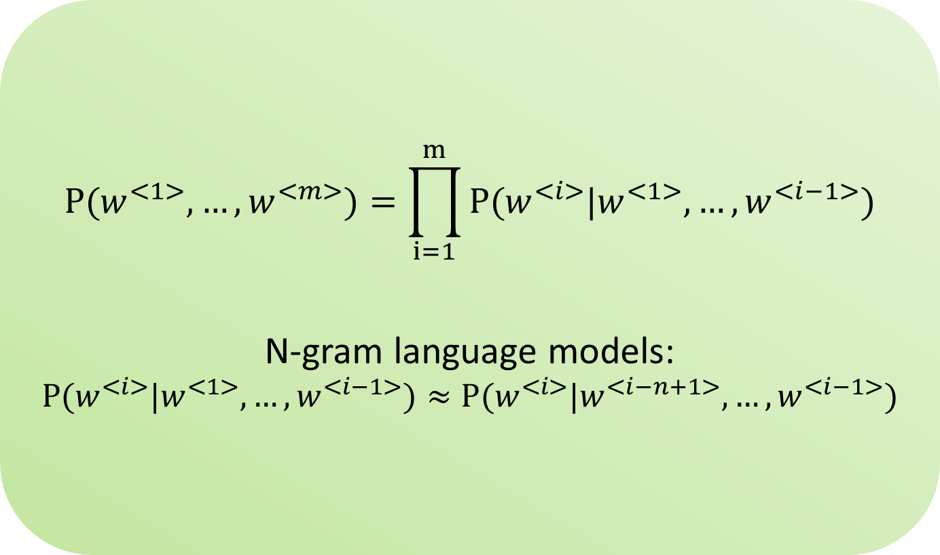
Language models
$$P(w^{<1>},…,w^{<m>})=\prod_{i=1}^{m}{P(w^{<i>}|w^{<1>},…,w^{<i−1>})}$$
N-gram language models:
$$P(w^{<i>}|w^{<1>},…,w^{<i−1>})≈P(w^{<i>}|w^{<i−n+1>},…,w^{<i−1>})$$

Slide 3
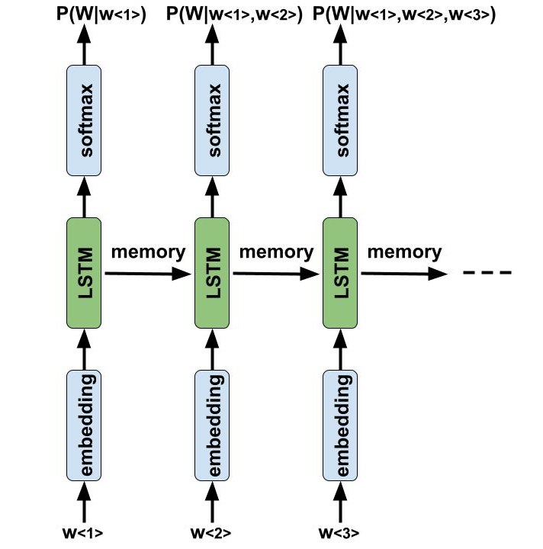
LSTM language models

Slide 4
LM based classification
Standard classifier architecture:
argmax_{y}p(y|x)
vs
Language models based classifier:
argmax_{y}p(x|y)

Slide 5
Model hyperparameters
25 D pretrained GloVe embeddings
64 D LSTM layer
̴23.000 trainable parameters
Regularization:
  recurrent dropout
  weight tying
Optimization:
  stochastic gradient descent, with decreasing learning rate

Slide 6
Data
PAN 2013 author profiling task
https://pan.webis.de/clef13/pan13-web/author-profiling.html
Class | Train | Dev | Test | Ratio
Females | 162321 | 20844 | 20846 | 50%
Males | 167867 | 20838 | 20839 | 50%
10s (13-17) | 22029 | 2811 | 2811 | 7%
20s (23-27) | 124589 | 15631 | 15633 | 37%
30s | 183570 | 23240 | 23241 | 56%
Total | 330188 | 41682 | 41685

Slide 7
Preliminary results
Accuracy per class and overall for gender
model | females | males | overall
classifier | 88,19 | 33,14 | 56,67
LM-s | 63,58 | 43,7 | 53,63
Accuracy per class and overall for age groups
model | 10s | 20s | 30s | overall
classifier | 0 | 35,79 | 88,73 | 62,89
LM-s | 4,62 | 32,67 | 78,78 | 56,49

Slide 8
Selected literature
Bengio, Yoshua, Réjean Ducharme, Pascal Vincent, Christian Janvin. „A Neural Probabilistic Language Model.” Journal of Machine Learning Research (JMLR.org) 3 (3 2003): 1137-1155.
Hochreiter, Sepp, és Jürgen Schmidhuber. „Long Short-Term Memory.” Neural Computation (MIT Press Journals) 9, 8. szám (11 1997): 1735-1780.
Hinton, Geoffrey E. „Learning distributed representations of concepts.” in: Parallel Distributed Processing: Implications for Psychology and Neurobiology. Amherst, Massachusetts: Clarendon Press/Oxford University Press, 1986. 46-61.
Inan, Hakan, Khashayar Khosravi, és Richard Socher. „Tying Word Vectors and Word Classifiers: A Loss Framework for Language Modeling.” Conference Track. ICLR, 2016.
Merity, Stephen, Nitish Shirish Keskar, és Richard Socher. „Regularizing and optimizing LSTM language models.” Conference Track Proceedings. ICLR, 2018.
Mikolov, Thomas. „Statistical Language Models Based on Neural Networks.” Vysoké Učení Technické v Brně, 2012.
Radford, Alec, Jeffrey Wu, Rewon Child, David Luan, Dario Amodei, Ilya Sutskever. „Language Models are Unsupervised Multitask Learners.” OpenAI, San Francisco, CA, 2019.
Thank you for your attention

