Slide 1
EVALUATING CANCER SCREENING PROGRAMMES USING SURVIVAL ANALYSIS
Author: Bor Vratanar
Supervisor: prof. dr. Maja Pohar Perme
Vorau, 16.10.2021

Slide 2
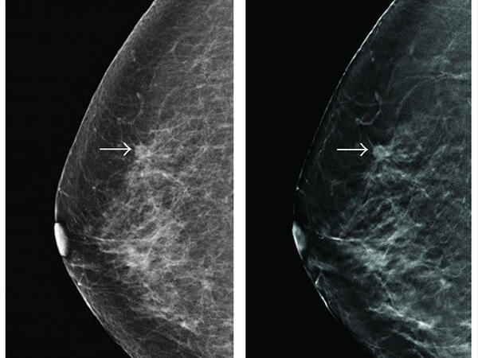
CANCER SCREENING PROGRAMMES (CSPs)
CSPs
Evaluating CSPs
Notation
Estimation
Aims
Purpose: identify cancer in an apparently healthy population so that early treatment can be offered
Hypothesis: early treatment is more successful in treating cancer
Example: breast CSP in Slovenia

Slide 3
HOW DO CSPs WORK?
CSPs
Evaluating CSPs
Notation
Estimation
Aims
NO CANCER
ACCEPT
INTERVAL CANCER
INVITATION
(whole population)
SCREEN-DETECTED CANCER
DECLINE
Only screen-detected cancers can benefit from CSPs!
CANCER
NO CANCER

Slide 4
EVALUATING CSPs
CSPs
Evaluating CSPs
Notation
Estimation
Aims
Define working hypothesis:

Slide 5
EVALUATING CSPs
CSPs
Evaluating CSPs
Notation
Estimation
Aims
Define working hypothesis: early treatment is more successful in treating cancer compared to delayed treatment
Define appropriate experimental (EG) and control group (CG):
EG: screen-detected cases treated at screen diagnosis (early treatment)
CG: screen-detected cases treated at symptoms (delayed treatment)
Observe relevant outcomes: survival time
Estimate: estimate survival curves for the experimental and control group
Statistical test: use statistical test to compare experimental and control group

Slide 6
HYPOTHETICAL EXPERIMENT
CSPs
Evaluating CSPs
Notation
Estimation
Aims
NO CANCER
ACCEPT
INTERVAL CANCER
INVITATION
(whole population)
SCREEN-DETECTED CANCER
DECLINE
TREAT AT SYMPTOMS
TREAT AT SCREEN DIAGNOSIS
CANCER
NO CANCER

Slide 7
OBSERVATIONAL STUDY
CSPs
Evaluating CSPs
Notation
Estimation
Aims
NO CANCER
ACCEPT
INTERVAL CANCER
INVITATION
(whole population)
SCREEN-DETECTED CANCER
DECLINE
TREAT AT SYMPTOMS
TREAT AT SCREEN DIAGNOSIS
CANCER
NO CANCER

Slide 8
OBSERVATIONAL STUDY
CSPs
Evaluating CSPs
Notation
Estimation
Aims
NO CANCER
ACCEPT
INTERVAL CANCER
INVITATION
(whole population)
SCREEN-DETECTED CANCER
DECLINE
TREAT AT SYMPTOMS
TREAT AT SCREEN DIAGNOSIS
CANCER
NO CANCER

Slide 9
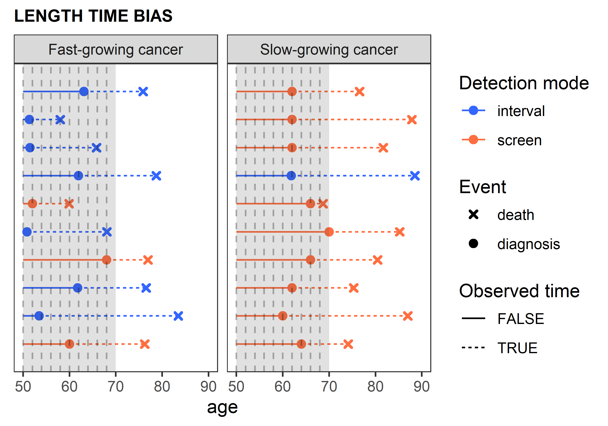
ALTERNATIVE CG #1: INTERVAL CANCERS
CSPs
Evaluating CSPs
Notation
Estimation
Aims
Interval cancers (treated at symptoms): a good choice for CG?
Detection mode
(interval vs screen-detected)
Survival time
Cancer growth speed

Slide 10
ALTERNATIVE CG #2: DECLINE INVITATION
CSPs
Evaluating CSPs
Notation
Estimation
Aims
Mixture of interval cases and screen-detected cases treated at symptoms that would be observed in another scenario
We propose a new method that allows us to extract the hypothetical survival curve of screen-detected cases in this group
Formal notation is needed

Slide 11
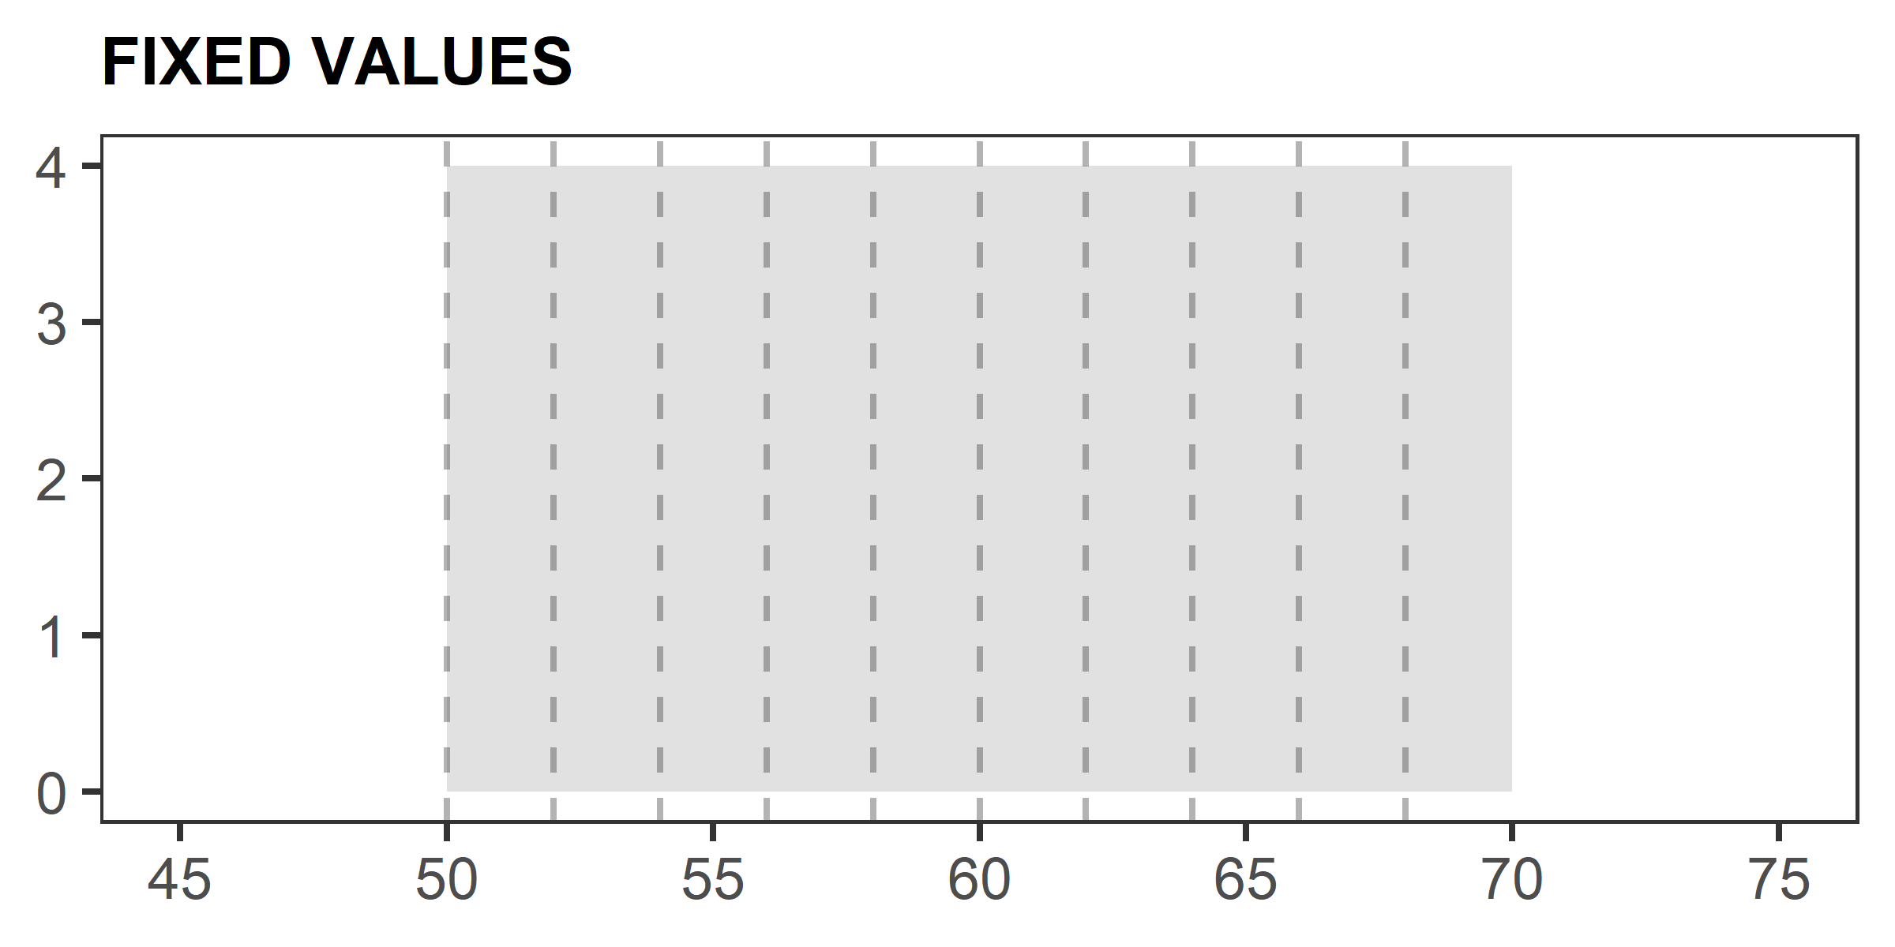
NOTATION
CSPs
Evaluating CSPs
Notation
Estimation
Aims
We adopt the notation of causal inference:
Treatment values $X∈\{0=decline invitation,1=accept invitation\}$
Let $U_{s\left(x\right)}$ be the potential outcome with notation s(x) indicating the action of setting X to x.
Fixed values:
a … age at first screening test
b … age at last possible screening test
m … screening interval (in years)
b+m

Slide 12
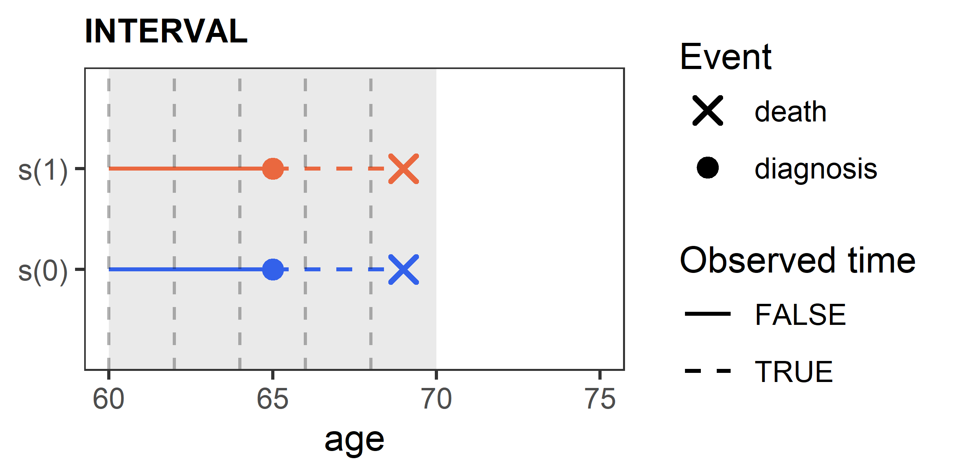
NOTATION
CSPs
Evaluating CSPs
Notation
Estimation
Aims
Random variables:
$T^{o}$… age at death from other causes
$G=\min\left(T^{o},b+m\right)$
Potential outcomes:
D … age at cancer diagnosis
$T^{c}$… age at death from cancer
$T_{s\left(x\right)}=min⁡(T^{o},T_{s\left(x\right)}^{c})$
$Y_{s\left(x\right)}\left(t\right)=I\left(t≥D_{s\left(x\right)}, D_{s\left(x\right)}<G\right)$
whether a cancer would be detected in s(x) by t
$Y_{s\left(1\right)}\left(D_{s\left(1\right)}\right)=1$
$Y_{s\left(1\right)}\left(D_{s\left(0\right)}\right)=1$
$Y_{s\left(0\right)}\left(D_{s\left(1\right)}\right)=1$
$Y_{s\left(0\right)}\left(D_{s\left(0\right)}\right)=1$

Slide 13
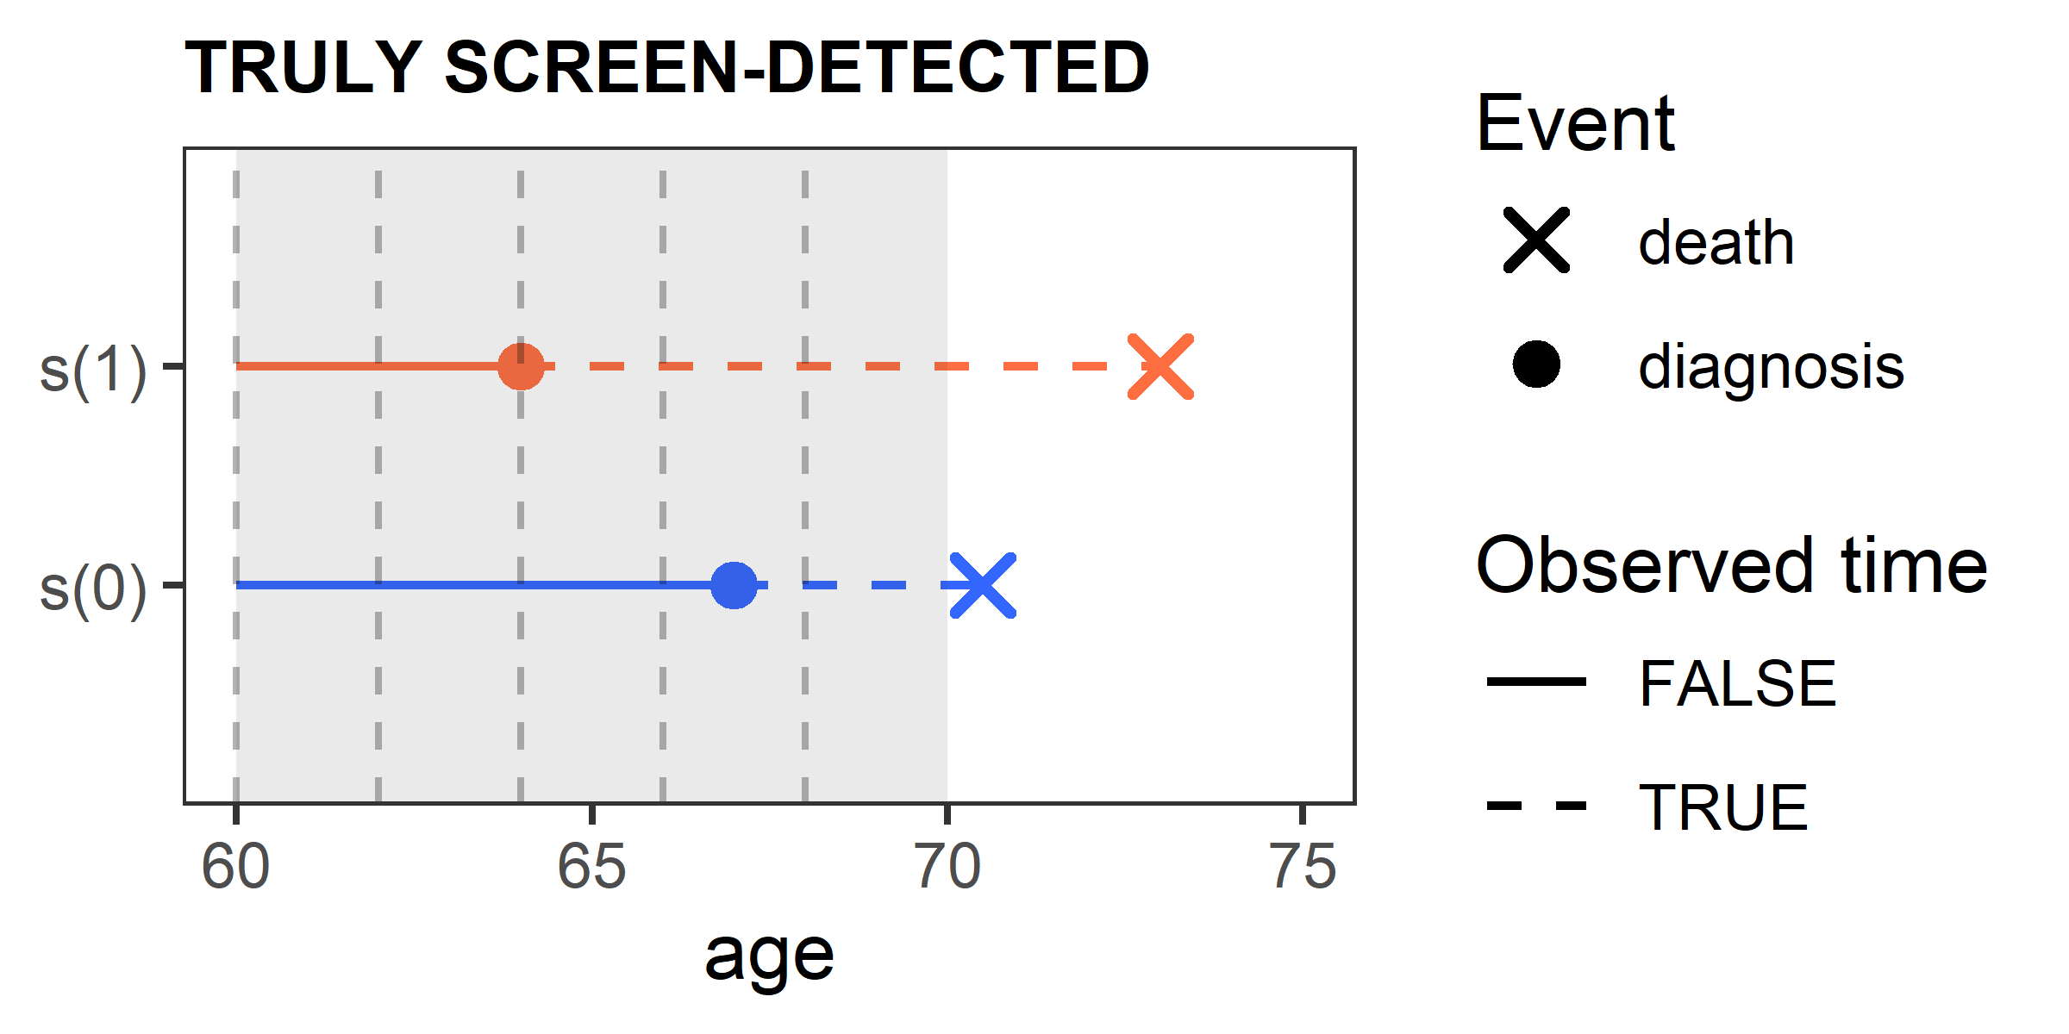
NOTATION
CSPs
Evaluating CSPs
Notation
Estimation
Aims
Random variables:
$T^{o}$… age at death from other causes
$G=\min\left(T^{o},b+m\right)$
Potential outcomes:
D … age at cancer diagnosis
$T^{c}$… age at death from cancer
$T_{s\left(x\right)}=min⁡(T^{o},T_{s\left(x\right)}^{c})$
$Y_{s\left(x\right)}\left(t\right)=I\left(t≥D_{s\left(x\right)}, D_{s\left(x\right)}<G\right)$
whether a cancer would be detected in s(x) by t
$Y_{s\left(1\right)}\left(D_{s\left(1\right)}\right)=1$
$Y_{s\left(1\right)}\left(D_{s\left(0\right)}\right)=1$
$Y_{s\left(0\right)}\left(D_{s\left(1\right)}\right)=0$
$Y_{s\left(0\right)}\left(D_{s\left(0\right)}\right)=1$

Slide 14
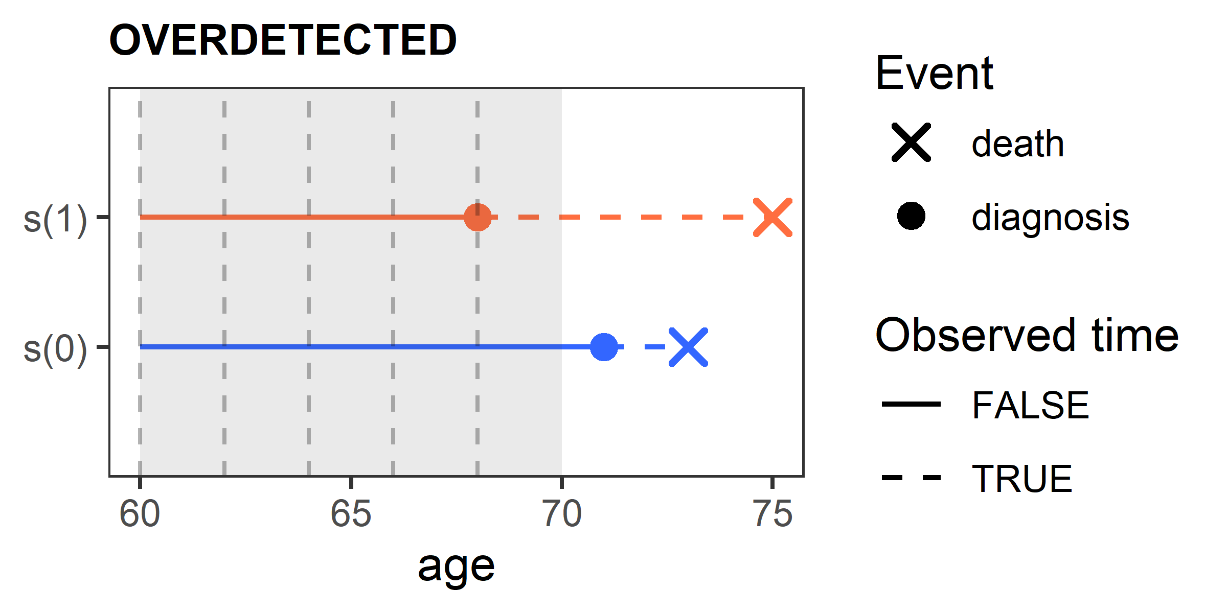
NOTATION
CSPs
Evaluating CSPs
Notation
Estimation
Aims
Random variables:
$T^{o}$… age at death from other causes
$G=\min\left(T^{o},b+m\right)$
Potential outcomes:
D … age at cancer diagnosis
$T^{c}$… age at death from cancer
$T_{s\left(x\right)}=min⁡(T^{o},T_{s\left(x\right)}^{c})$
$Y_{s\left(x\right)}\left(t\right)=I\left(t≥D_{s\left(x\right)}, D_{s\left(x\right)}<G\right)$
whether a cancer would be detected in s(x) by t
$Y_{s\left(1\right)}\left(D_{s\left(1\right)}\right)=1$
$Y_{s\left(1\right)}\left(D_{s\left(0\right)}\right)=0$
$Y_{s\left(0\right)}\left(D_{s\left(1\right)}\right)=0$
$Y_{s\left(0\right)}\left(D_{s\left(0\right)}\right)=0$

Slide 15
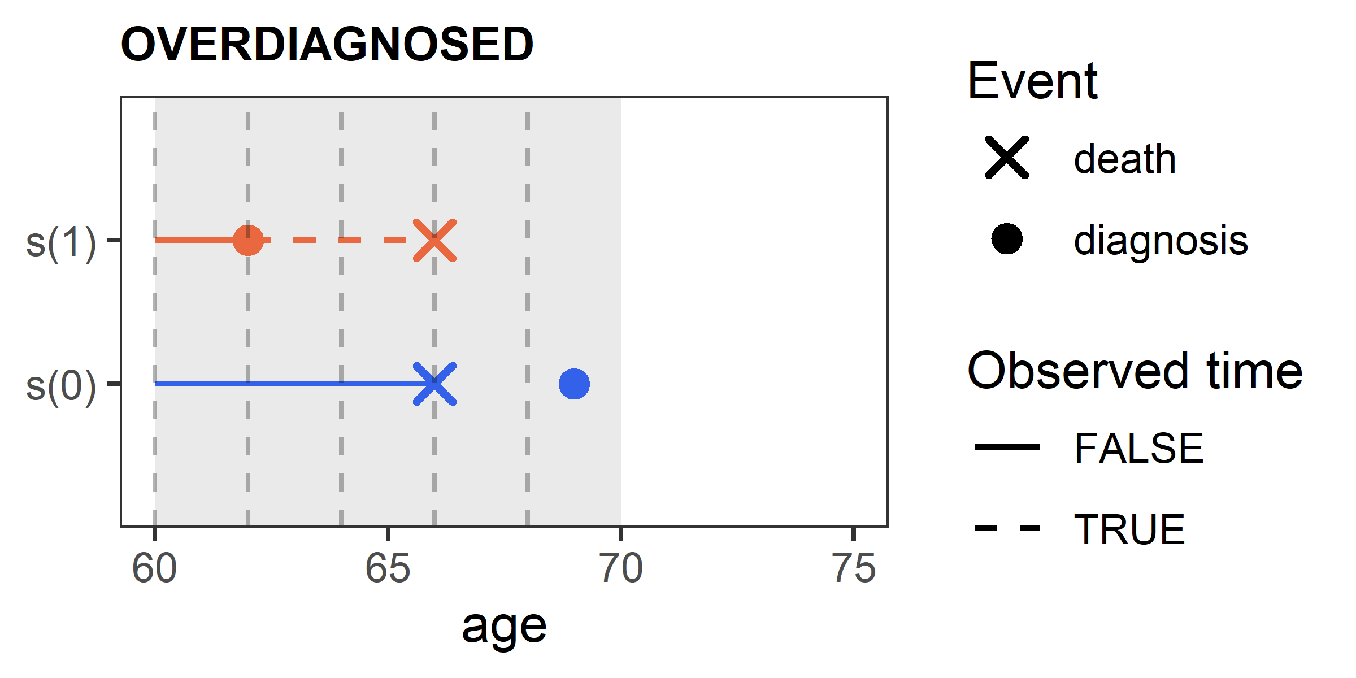
NOTATION
CSPs
Evaluating CSPs
Notation
Estimation
Aims
Random variables:
$T^{o}$… age at death from other causes
$G=\min\left(T^{o},b+m\right)$
Potential outcomes:
D … age at cancer diagnosis
$T^{c}$… age at death from cancer
$T_{s\left(x\right)}=min⁡(T^{o},T_{s\left(x\right)}^{c})$
$Y_{s\left(x\right)}\left(t\right)=I\left(t≥D_{s\left(x\right)}, D_{s\left(x\right)}<G\right)$
whether a cancer would be detected in s(x) by t
$Y_{s\left(1\right)}\left(D_{s\left(1\right)}\right)=1$
$Y_{s\left(1\right)}\left(D_{s\left(0\right)}\right)=0$
$Y_{s\left(0\right)}\left(D_{s\left(1\right)}\right)=0$
$Y_{s\left(0\right)}\left(D_{s\left(0\right)}\right)=0$

Slide 16
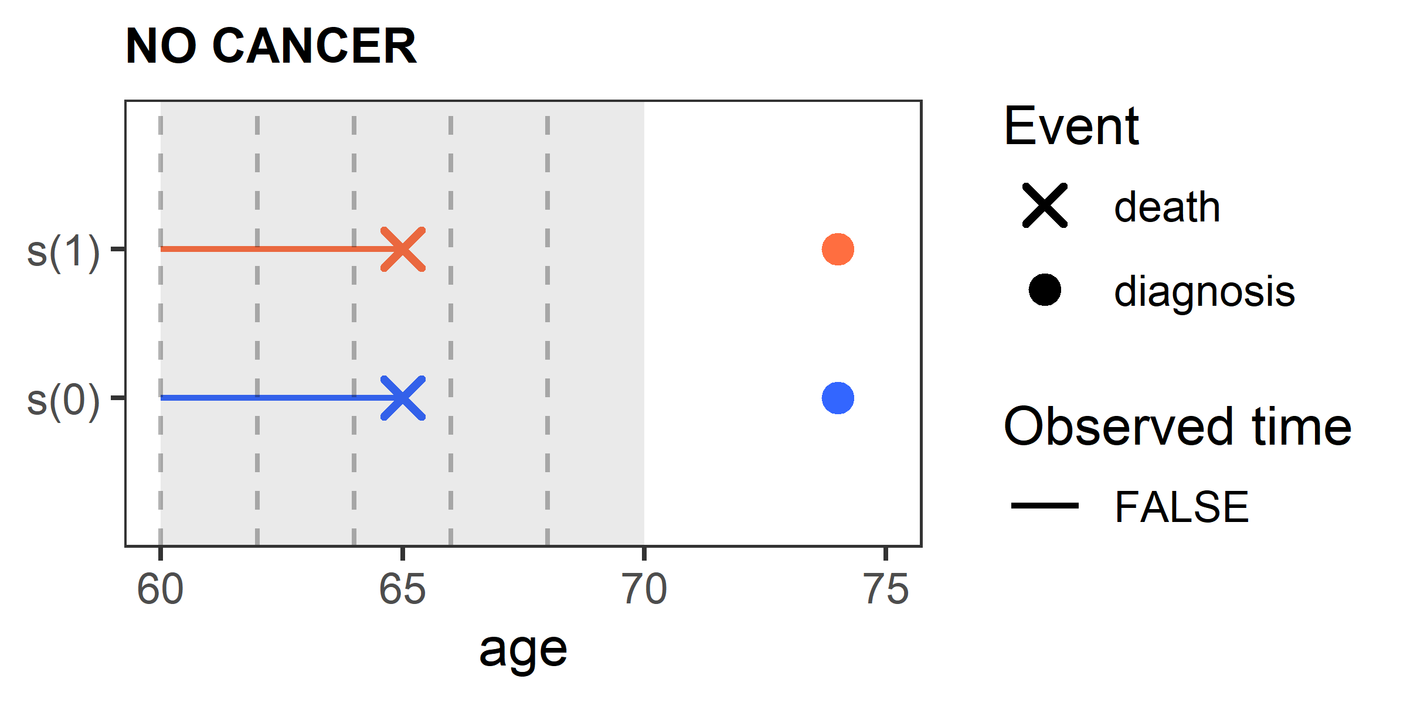
NOTATION
CSPs
Evaluating CSPs
Notation
Estimation
Aims
Random variables:
$T^{o}$… age at death from other causes
$G=\min\left(T^{o},b+m\right)$
Potential outcomes:
D … age at cancer diagnosis
$T^{c}$… age at death from cancer
$T_{s\left(x\right)}=min⁡(T^{o},T_{s\left(x\right)}^{c})$
$Y_{s\left(x\right)}\left(t\right)=I\left(t≥D_{s\left(x\right)}, D_{s\left(x\right)}<G\right)$
whether a cancer would be detected in s(x) by t
$Y_{s\left(1\right)}\left(D_{s\left(1\right)}\right)=$ 0
$Y_{s\left(1\right)}\left(D_{s\left(0\right)}\right)=0$
$Y_{s\left(0\right)}\left(D_{s\left(1\right)}\right)=0$
$Y_{s\left(0\right)}\left(D_{s\left(0\right)}\right)=0$

Slide 17
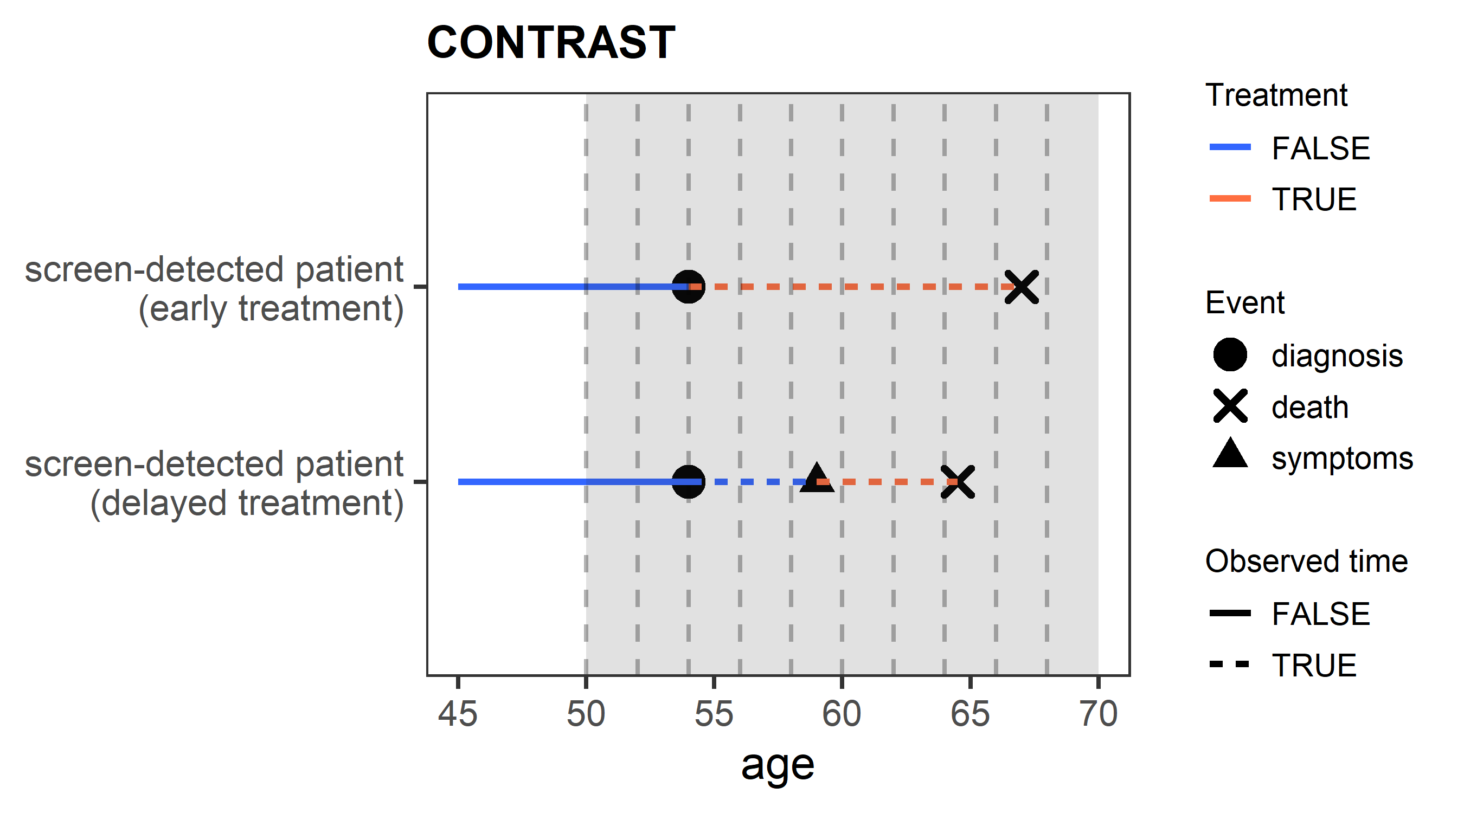
CONTRAST
CSPs
Evaluating CSPs
Notation
Estimation
Aims
S($t | Y_{s\left(1\right)}(D_{s\left(1\right)})=1, Y_{s\left(0\right)}(D_{s\left(1\right)})=0, s\left(1\right), t>D_{s\left(1\right)}$)
vs
$\text{S}\text{(}t | Y_{s\left(1\right)}(D_{s\left(1\right)})=1, Y_{s\left(0\right)}(D_{s\left(1\right)})=0, s\left(0\right), t>D_{s\left(1\right)}\text{)}$

Slide 18
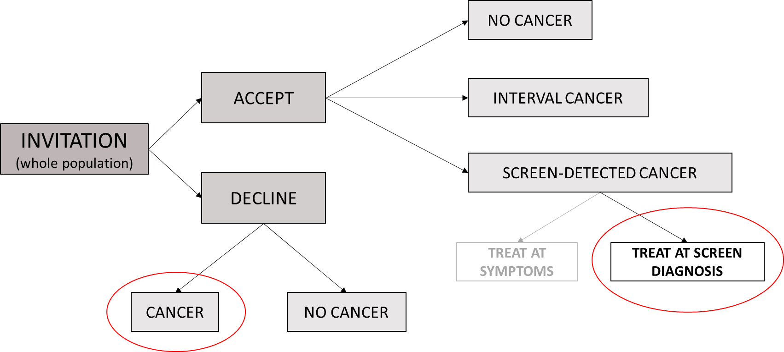
ESTIMATION
CSPs
Evaluating CSPs
Notation
Estimation
Aims
S($t | Y_{s\left(1\right)}(D_{s\left(1\right)})=1, Y_{s\left(0\right)}(D_{s\left(1\right)})=0, s\left(1\right), t>D_{s\left(1\right)}$)
$\text{S}\text{(}t | Y_{s\left(1\right)}(D_{s\left(1\right)})=1, Y_{s\left(0\right)}(D_{s\left(1\right)})=0, s\left(0\right), t>D_{s\left(1\right)}\text{)}$

Slide 19
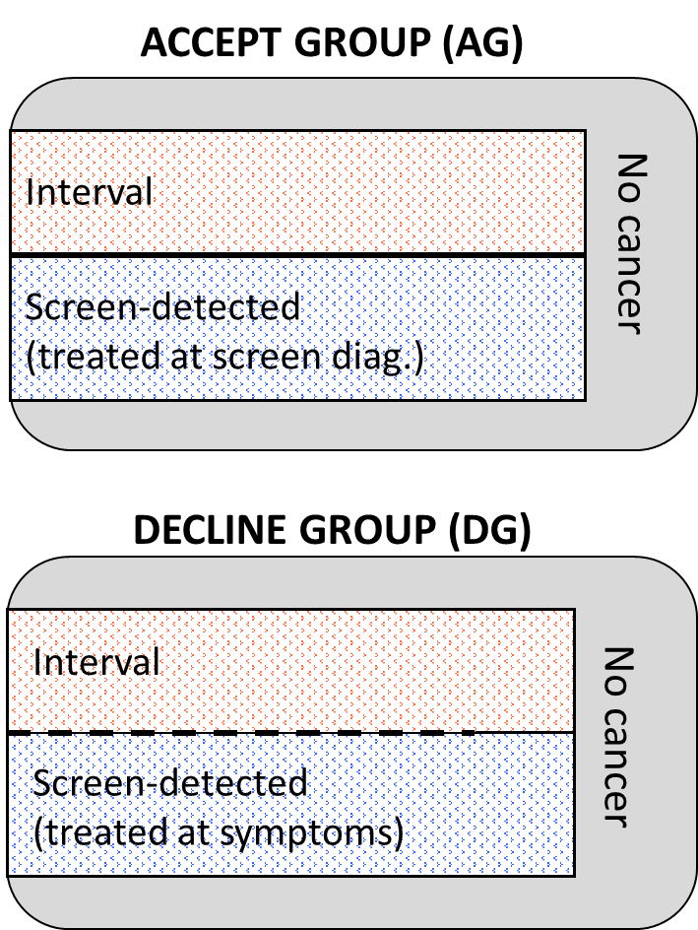
PROPOSED METHOD
CSPs
Evaluating CSPs
Notation
Estimation
Aims
Assumptions:
Assume that the patients in DG are the same with respect to cancer-related variables to the group of patients in AG
Assume also that the two groups do not differ with respect to other cause mortality
Consequently (based on the assumptions above):
The proportion of interval ($w_{2}$) and screen-detected cancers ($w_{1}$) is the same between AG and DG
$S\left(t | AG, interval\right)$ = $S\left(t | DG, interval\right)$
$$w_{1}+w_{2}=1$$
$T_{0}$= diagnosis
Red = observed
$$S\left(t | AG, cancer\right)=w_{1}∗S\left(t | AG, screen\right)+w_{2}∗S\left(t | AG, interval\right)$$
$$S\left(t | DG, cancer\right)=w_{1}∗S\left(t | DG, screen\right)+w_{2}∗S\left(t | DG, interval\right)$$

Slide 20
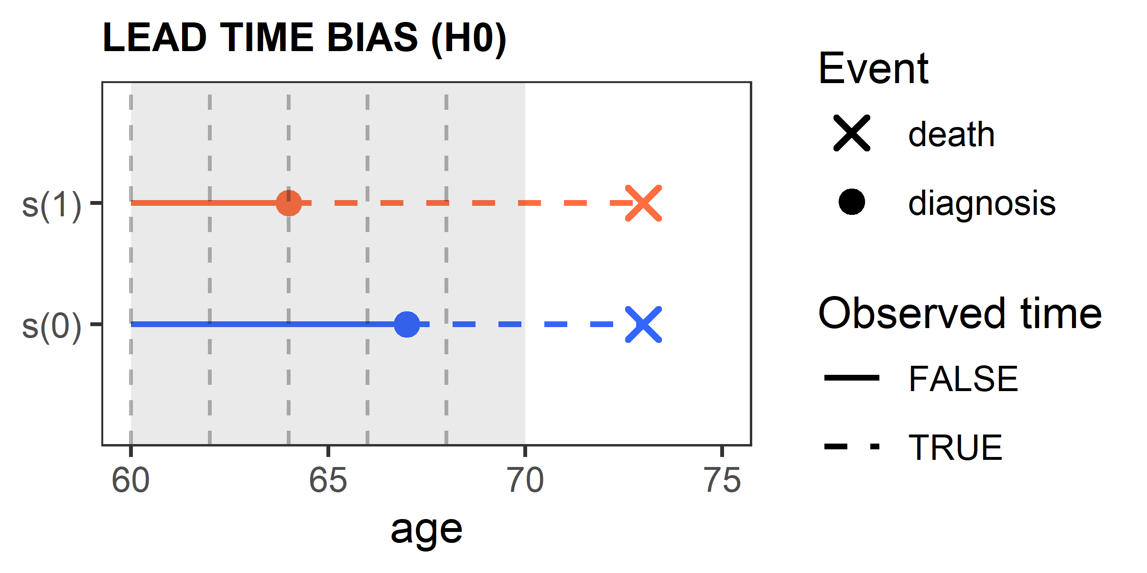
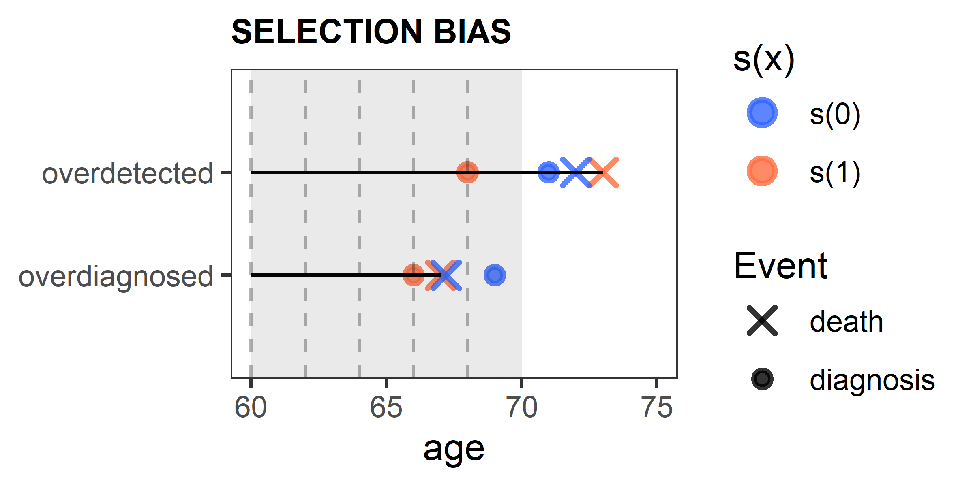
SOME PROBLEMS REMAIN…
CSPs
Evaluating CSPs
Notation
Estimation
Aims
Lead time bias: screen-detected cases are diagnosed with cancer at an earlier time in s(0) than in s(1)
Selection bias: we might detect some (typically slow-growing) cancers in s(1) but not in s(0)

Slide 21
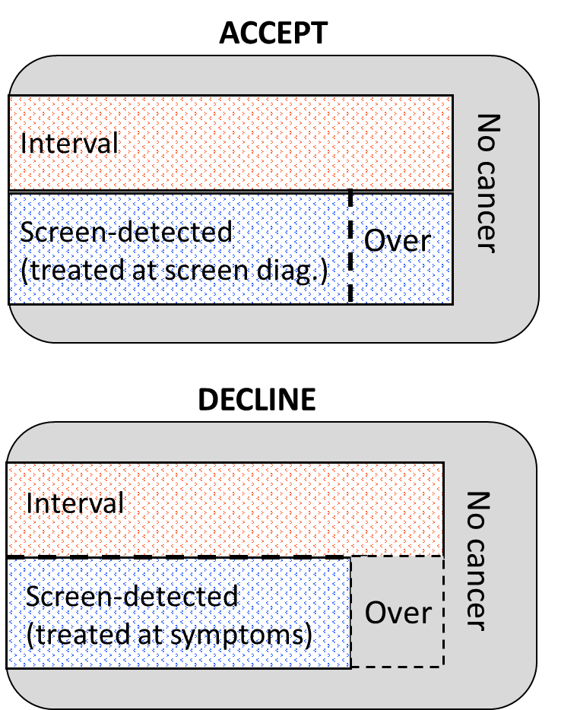
PROPOSED METHOD
CSPs
Evaluating CSPs
Notation
Estimation
Aims
Estimate the number of “missing” cancer cases in DG
Impute age at diagnosis for “missing” cancer cases in DG
Estimate the distribution of lead time (L) via deconvolution: $D_{DG}=D_{AG}+L$
By sampling values from L:
one can “find” overdetected and overdiagnosed cases in AG
one can eliminate lead time bias
Extract the survival curve for screen-detected cases in DG
Compare the survival curve for screen-detected cases in DG and AG using bootstrap procedure

Slide 22
AIMS
CSPs
Evaluating CSPs
Notation
Estimation
Aims
Define and explore different sources of bias that occur when evaluating the effectiveness of CSPs.
Develop a non-parametric methodology for evaluation of the effectiveness of CSPs.
Examine the properties of the proposed method.
Illustrate the proposed method using data from the Slovenian breast cancer screening programme DORA.

