Slide 1
Topic Modelling with Latent Dirichlet Allocation Method in Social Sciences – Case Study of Web of Science
Maja Buhin Pandur, Full Prof. Jasminka Dobša, Ph.D.
University of Zagreb
Faculty of Organization and Informatics, Varaždin
Dr. Luka Kronegger, Assistant Professor
University of Ljubljana
Faculty of Social Sciences
25th Young Statisticians Meeting
October, 2021
Notes:
I will present to you the research I have done together with my mentors Luka and Jasminka.

Slide 2
Content
Introduction
Methods
Latent Dirichlet Allocation topic modelling
Measures for model evaluation
Experimental Results
Dataset and preprocessing
Data analysis
Results
Conclusion
References

Slide 3
Introduction
Interdisciplinary research is defined as “a process of answering a question, solving a problem or addressing a topic that is too broad or complex to be dealt with adequately by a single discipline and draws on the disciplines with the goal of integrating their insights to construct a more comprehensive understanding” (Repko, 2008)
In scientometrics, research interdisciplinarity is quantified by examining the network of citations and measuring the percentage of citations outside the main discipline of the citing paper
Topic modelling is the process of identifying topics in a set of documents
One of the techniques used for topics modelling is Latent Dirichlet Allocation (LDA)
Goal: investigate whether LDA topic modelling could represent a valid alternative for researcher’s interest in identifying interdisciplinary fields directly from the textual content of papers titles, abstracts, or keywords
Notes:
In the last few years, interdisciplinarity between scientific disciplines has increased. Interdisciplinarity is not only important in the academic world but also in other areas.
In the literature, interdisciplinary research………..
In scientometrics ……….
The automatic identification of interdisciplinarity from a text has already been attempted with text mining approaches used the (LDA) for topic modelling.
The goal of the presented analysis is to investigate whether text mining methods, such as (LDA) topic modelling, could represent a valid alternative for researcher’s interest in identifying interdisciplinary fields directly from the textual content of papers titles, abstracts, or keywords.

Slide 4
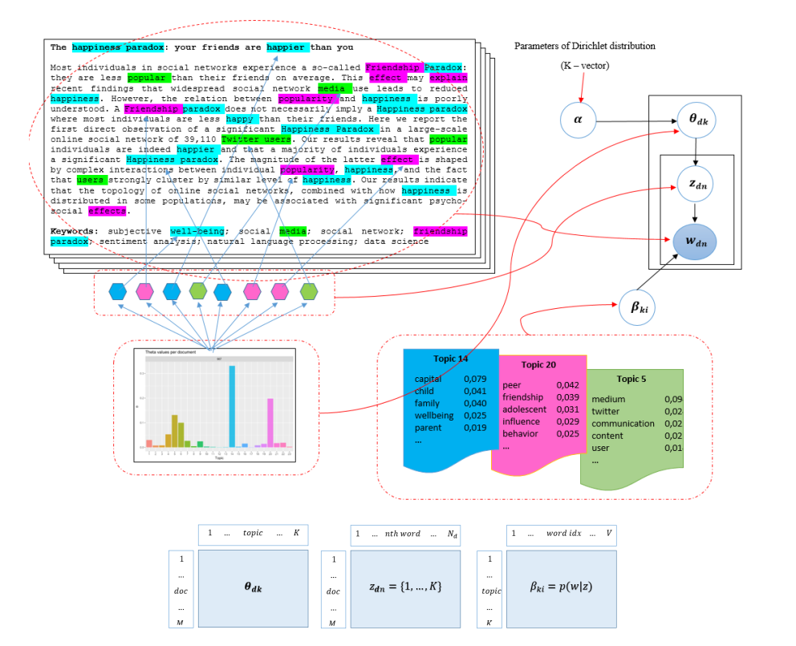
Methods
Latent Dirichlet Allocation (LDA) is a generative, probabilistic hierarchical Bayesian model that induces topics from a document collection (Blei et al., 2003; Blei, 2012)
Documents are represented as random mixtures over latent topics
Each word in the documents is selected (allocated) from one of the topics
Topics are represented by a distribution over words
Notes:
Topic modelling is one of the most popular topics investigated in the area of Natural Language Processing. One of the techniques used for topics modelling is Latent Dirichlet Allocation (LDA). It is an unsupervised machine learning technique which creates topics using a collection of documents based on words or n-grams with similar meaning. LDA is a generative, probabilistic hierarchical Bayesian model that induces topics from a document collection in three steps :
1. Each document in the collection is distributed over topics that are sampled for that document based on the Dirichlet distribution. 2. Each word in the document is connected with one single topic based on chosen Dirichlet distribution. 3. Each topic is signified as a multinomial distribution over words that are assigned to the sampled topic

Slide 5
Experimental Results Dataset and Preprocessing
Collect Data
Dataset contains 3,664 articles from Web of Science (WoS) Core Collection in Social Science research area (25 categories) from 1999 to 2019
Articles contain phrase social network* for the purpose of narrowing of the monitored set of data
Every article is represented by its text in the title, abstract and keywords
The collection is preprocessed by removing English stopwords and numbers, and removing high frequently words: social, network, study, analysis, model and datum
It is performed a lemmatisation
It is created term-document matrix using tf-idf weighting scheme
The collection is represented by a bag of words model using terms that appear in at least 2 documents from the corpus (3,663 documents)
The final number of index terms – 9,096
Prepare Data
Notes:
The dataset was obtained from the Web of Science (WoS) Core Collection database by searching articles containing phrase social network* in the WoS Social Science research area in the period from 1999 to 2019. Each of these articles is described with a series of metadata. Text in the title, abstract and keywords were extracted from each article and merged to get a dataset of one variable and 3,664 instances. Before analysis, the collection is preprocessed …..
It is created term-document matrix using tf-idf weighting scheme.
To reduce the sparsity of matrix, we ejected the index terms appearing in only one document. After this, the corpus contained 3,663 documents and 9,096 terms.

Slide 6
Experimental Results Data analysis
Train Model
Create Document Term Feature from corpus and applied LDA (specified 2 to 100 target topics)
Approaches from LDA:
how words are associated with topics
to examine documents that are estimated to be highly related to each topic
Notes:
In the next step, we built the Document Term Feature from the corpus and applied the LDA. Before estimating the LDA, we set different values for the number of topics from 2 to 100 to explore how many topics are suitable.
The LDA has two approaches to explore the topics that are estimated. The first approach is to look at how words are associated with topics, and the second approach is to examine documents that are estimated to be highly related to the specific topic.

Slide 7
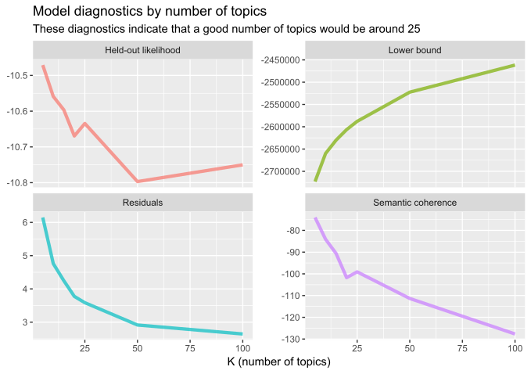
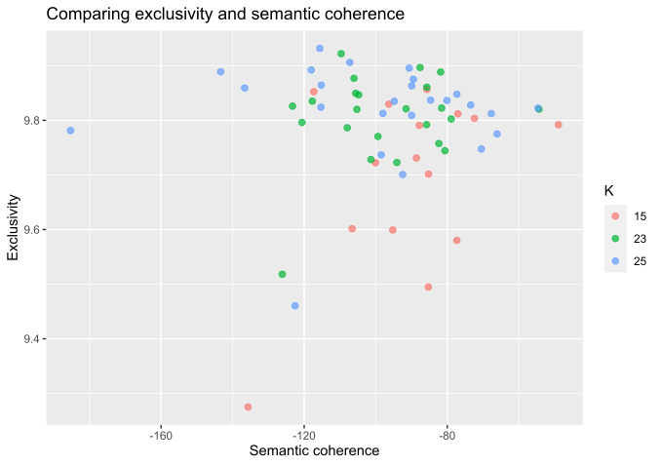
Experimental Results Results
model evaluation – semantic coherence, likelihood for held-out datasets, residuals and lower bound
The similarity between topics obtained by LDA and WoS categories is measured as cosine similarity between the vectors of the word probability distribution of topics and centroids for certain WoS category
The values of the cosine of angle are between 0 and 1
Topics from topic modelling are similar to the category from WoS if the value of cosine similarity is greater than 0.5
Evaluate
Notes:
Then, the model is evaluated with measures of semantic coherence of the topics, the likelihood for held-out datasets, residuals and lower bound by making some diagnostic plots to understand how the models perform for the different number of topics and to choose a target number of topics. From diagnostic plots, we could see that a good number of topics would be around 25 since around that value growth/fall of corresponding measures of evaluation slows down. When we looked at both semantic coherence and exclusivity of terms to topics together, we could assume that a good choice of the number of topics was 23.
The topics are then compared with centroids of WoS categories by using cosine similarity. We considered that topics from topic modelling are similar to the category from WoS if the value of cosine similarity is greater than 0.5.
*** Semantic coherence is maximized when the terms with the highest probability in a given topic frequently co-occur together, and it is a metric that correlates well with the human judgment of topic quality. If there are a few topics that dominate with very prevalent terms, then it is necessary to look at both semantic coherence and exclusivity.
Exclusivity measures the difference between topics by comparing the similarities of word distribution 𝛽 in various topics. A topic is exclusive if the top words cannot exist among other topics.
The held-out likelihood estimation is similar to cross-validation and helps to estimate the model’s prediction performance. Residuals measures whether there is overdispersion of the variance of the multinomial variance within the LDA method of generating data. The lower bound is a measure of convergence of the model. Once the bound has a small enough change between iterations, the model is considered converged.

Slide 8
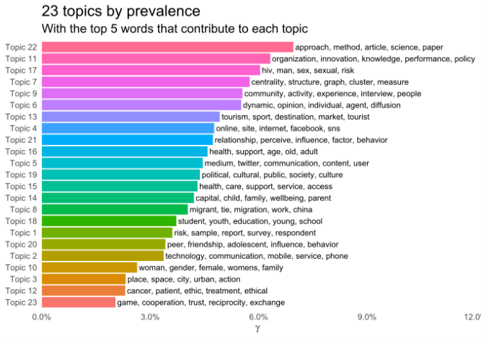
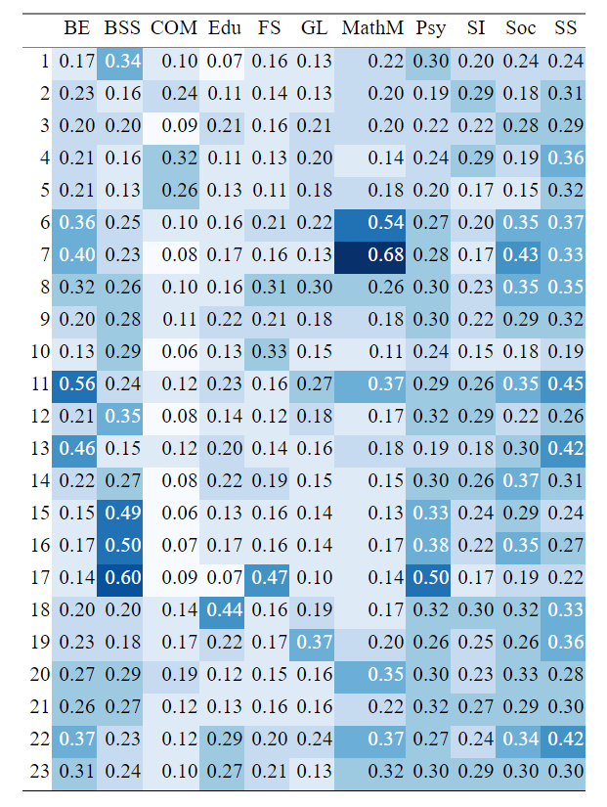
Experimental Results Results
Visualization
Cosine similarity between topics and selected WoS categories
Notes:
Each document is strongly associated with a single topic. We can see that the most documents belong to topic 22.
We can also see that several topics are focused to health (Topic 17,; Topic 16; Topic 15), communication, internet and social networks (Topic 5; Topic 4), tourism, political themes, or business and economics.
In the table on the right, it is presented the cosine similarity between vectors based on word probability distribution from topics and centroids for chosen WoS categories.
We can see that some topics have something in common with the categories from WoS. For example, Topic 7 is related to the Mathematical Methods in Social Sciences, Topic 17 to Biomedical Social Sciences, and Topic 11 to Business and Economics.
We can also notice that some topics do not overlap with only one category from WoS but several, so we can assume that there is interdisciplinarity between these scientific disciplines from WoS, which is not surprising, because most articles are categorized into multiple disciplines. Topic 22 has approximately equal values of cosine similarity for Business and Economics, Mathematical Methods in Social Sciences, Sociology and Social Sciences – Other Topics, while topic 17 has approximately equal values of cosine similarity for Biomedical Social Sciences, Family Studies, and Psychology.
Another thing we noticed is that individual areas from the WoS categories have approximately equal cosine similarity values for different topics. We can assume that this is because the LDA algorithm identified subcategories within this category. For example, Sociology has approximately equal cosine similarity values for topics 6, 7, 8, 11, 14, 16, 20 and 22.

Slide 9
Conclusion
Future Work
The main goal: compare latent topics with categories from WoS
The research was conducted on the sample of papers from 1999 to 2019 with the phrase social network* for the purpose of narrowing of the monitored set of data
Social networks are mainly applied in disciplines of Business and Economics (BE), Biomedical Social Sciences (BSS), Mathematical Methods in Social Sciences (MathM) and Psychology (Psy)
Based on cosine similarities, we could identify interdisciplinarity between disciplines of BE and MathM, BSS and MathM, BSS and Psy, BSS, FS, and Psy
We plan to extend our research to all papers in WoS in the field of Social Sciences to identify interdisciplinary fields
In future research, we intend to investigate the interdisciplinarity between science disciplines which are hidden or masked and reconsider the existing taxonomy of research areas in Social Sciences and its temporal changes
Notes:
The main goal of the research was to compare topics obtained by LDA topic modelling with categories of Web of Science Core Collection for the field of Social Sciences. The research was conducted on the sample of papers from 1999 to 2019 with the keyword social network* and the results are restricted to publications containing that phrase. The comparison between the topic obtained by LDA and the given taxonomy in terms of cosine similarity indicates that social networks are mainly applied in disciplines of Business and Economics (BE), Biomedical Social Sciences (BSS), Mathematical Methods in Social Sciences (MathM) and Psychology (Psy) which seems like an intuitive result. Based on cosine similarities, we were also able to identify interdisciplinarity between disciplines of BE and MathM, BSS and MathM, BSS and Psy, BSS, Family Studies, and Psy .
Based on the intuitive results, we plan ……
Also, we intend to ……

Slide 10
References
Bischof, J., Airoldi, E. (2012). Summarizing Topical Content with Word Frequency and Exclusivity. Proceedings of the 29th International Conference on Machine Learning, ICML ’12 (pp. 201–208). New York: J. Langford, J. Pineau (eds.).
Blei, D. M., Ng, A. Y., Jordan, M. I. (2003). Latent Dirichlet Allocation. Journal of Machine Learning Research 3, pp. 993-1022.
Chuang, J., Ramage, D., Manning, C., Heer, J. (2012). Interpretation and trust: designing model-driven visualizations for text analysis. SIGCHI Conference on Human Factors in Computing Systems, (pp. 443-452). Austin, Texas, USA.
Dietz, L., Bickel, S., Scheffer, T. (2007). Unsupervised prediction of citation influences. 24th international conference on Machine learning (pp. 233-240). Corvalis, Oregon, USA: Association for Computing Machinery, New York, United States.
Gerrish, S., Blei, D. (2010). A Language-based Approach to Measuring Scholarly Impact. 27th International Conference on Machine Learning, (pp. 375-382). Haifa, Israel.
Griffiths, T., Steyvers, M. (2004). Finding scientific topics. Proceedings of the National Academy of Sciences, 101, pp. 5228-5235.
Hall, D., Jurafsky, D., Manning, C. D. (2008). Studying the History of Ideas Using Topic Models. Conference on Empirical Methods in Natural Language Processing, (pp. 363–371).
Mimno, D., Wallach, H. M., Talley, E., Leenders, M., McCallum, A. (2011). Optimizing semantic coherence in topic models. Conference on Empirical Methods in Natural Language Processing (EMNLP ’11) (pp. 262-272). USA: Association for Computational Linguistics.
Nanni, F., Dietz, L., Ponzetto, S. P. (2018). Toward a computational history of universities: Evaluating text mining methods for interdisciplinarity detection from PhD dissertation abstracts. Digital Scholarship in the Humanities, Volume 33, Issue 3, pp. 612–620.
Nichols, L. G. (2014). A topic model approach to measuring interdisciplinarity at the National Science Foundation. Scientometrics 100(3), pp. 741-754.
Ramage D., Manning C. D., Dumais S. (2011). Partially labelled topic models for interpretable text mining. 17th ACM SIGKDD international conference on Knowledge discovery and data mining (pp. 457-465). San Diego California USA: Association for Computing Machinery New York NY United States.
Repko, A. F. (2008). Interdisciplinary Research: Process and Theory. California: Sage: Thousand Oaks.
Roberts, M. E., Stewart, B. M., Tingley, D. (August 2020). stm: R Package for Structural Topic Models. Retrieved from The Comprehensive R Archive Network: http://www.structuraltopicmodel.com/
Silge, J., Robinson, D. (August 2020). Text Mining with R. Retrieved from https://www.tidytextmining.com/topicmodeling.html
Taddy, M. A. (2012). On Estimation and Selection for Topic Models. The 15th International Conference on Artificial Intelligence and Statistics., (pp. 1184-1193).

Slide 11
Thank You
For Your Attention

